Slide 1
利用网络上公开的数据 构建证券知识图谱
Author：lemonhu
https://github.com/lemonhu/stock-knowledge-graph
Nov. 12, 2019
Slides by Hongfei Yan
Notes:
https://github.com/lemonhu/stock-knowledge-graph

Slide 2
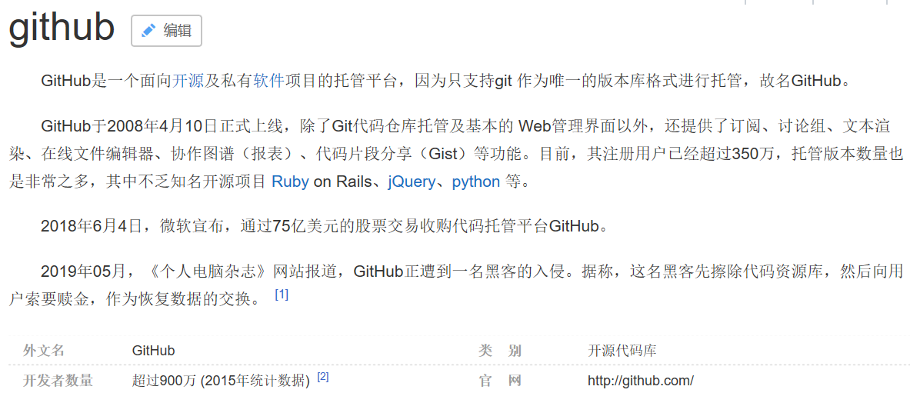

Slide 3
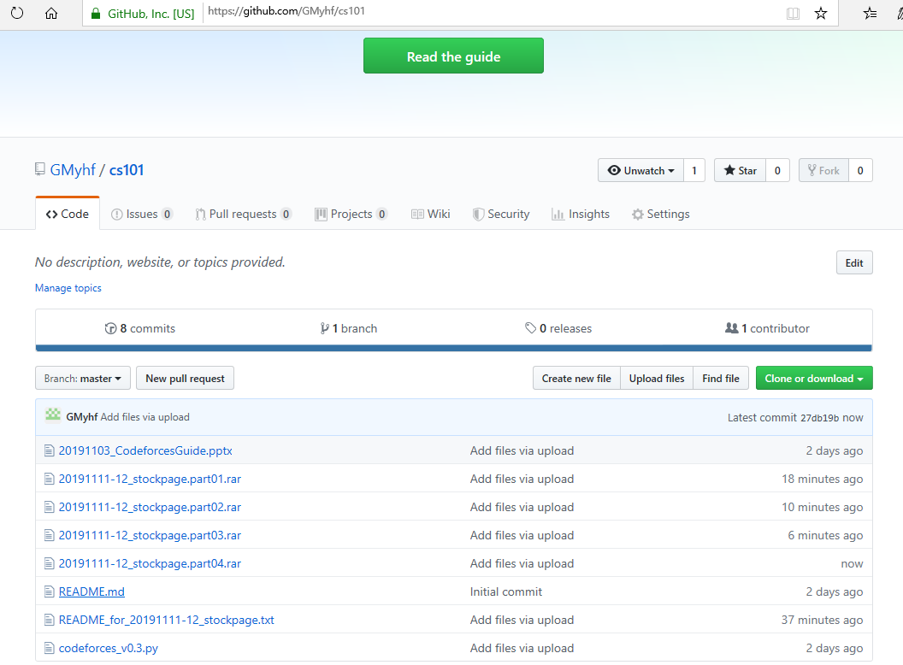
Notes:
https://github.com/GMyhf/cs101
Goal：抓取3734个A股标的对应的网页
（包括：公司情况、高管简介、发行情况、参股控股公司等信息）
Begin time: 2019/11/11 13:53
End time: 2019/11/12 9:50
19 hours，crawled 3718 web pages, 511MB
Future work: 有16个网页没有抓到。可以忽略，或者人工浏览器访问保存下来。
====
seed_urls.txt
crawl_stock_page_Selenium.py

Slide 4
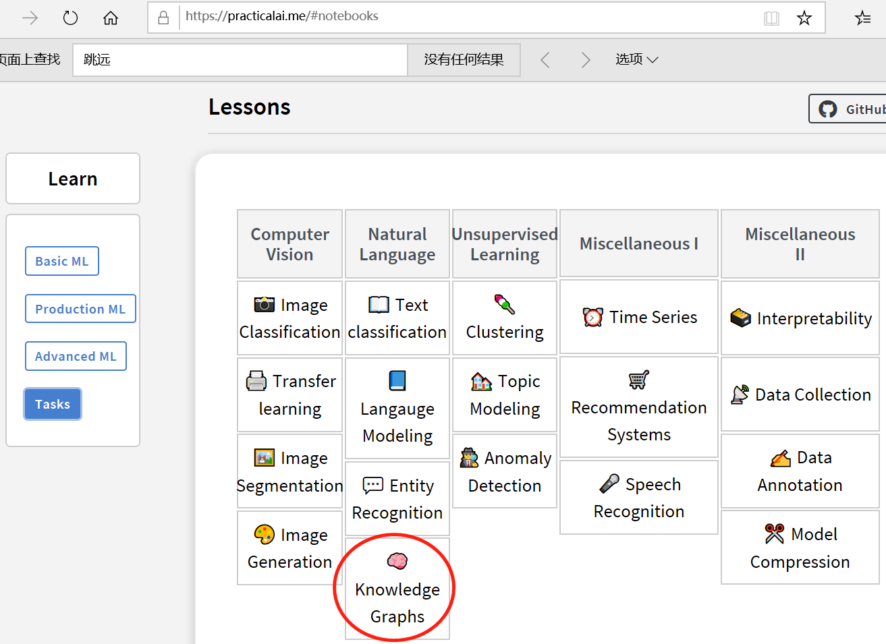
Notes:
https://practicalai.me/

Slide 5
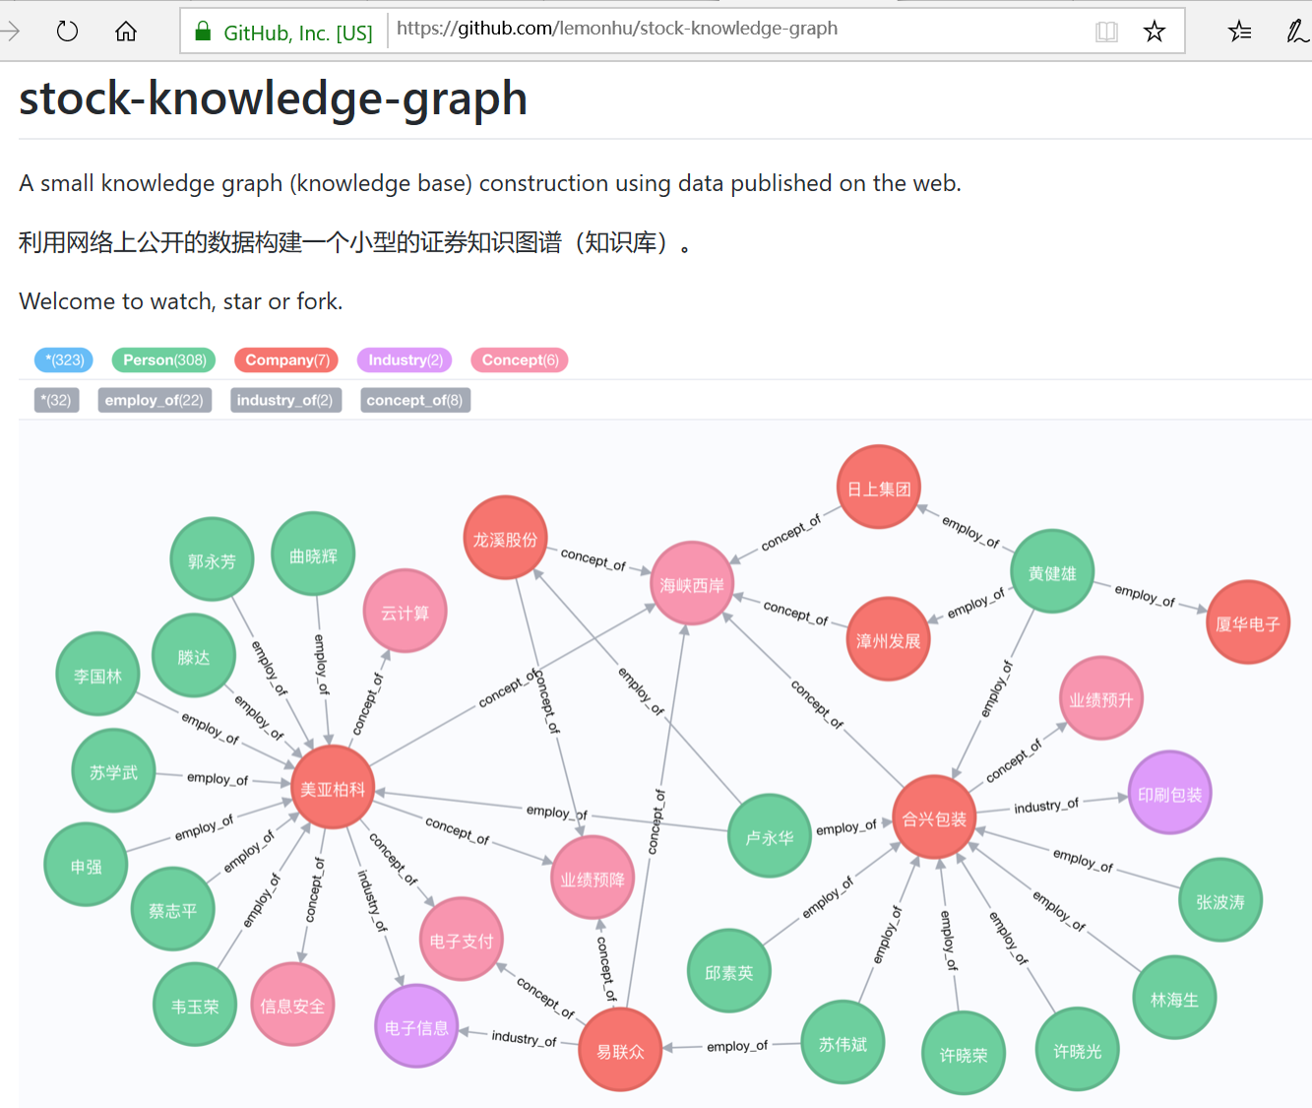
Notes:
https://github.com/lemonhu/stock-knowledge-graph

Slide 6
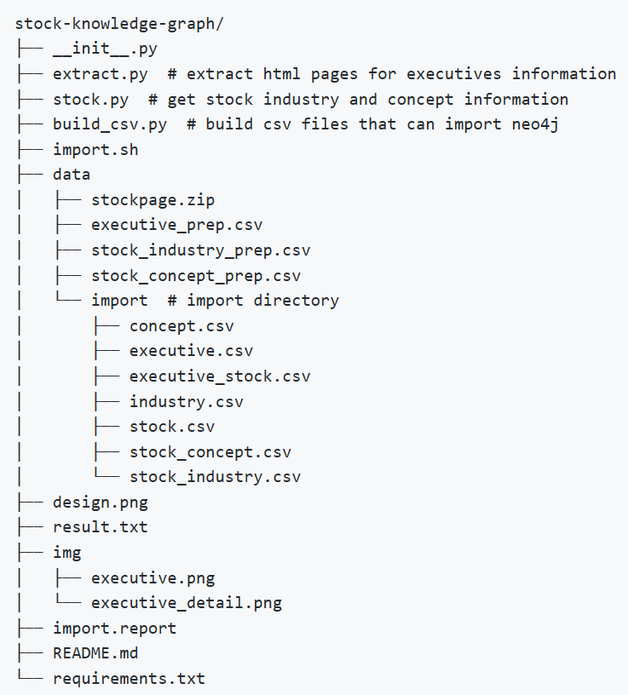
工程目录结构

Slide 7
数据源
用到两种数据源：
公司董事信息，股票的行业以及概念信息。
公司董事信息
在data目录下的stockpage压缩文件中，⾥面的每一个文件是以XXXXXX.html命名，其中XXXXXX是股票代码.
是由同花顺个股的⽹页爬取而来的，执行解压缩命令unzip stockpage.zip即可获取。比如对于600007.html，这部分内容来自于http://stockpage.10jqka.com.cn/600007/company/#manager
股票行业以及概念信息
通过⽹上公开的信息得到。这里使用Tushare工具来获得.

Slide 8
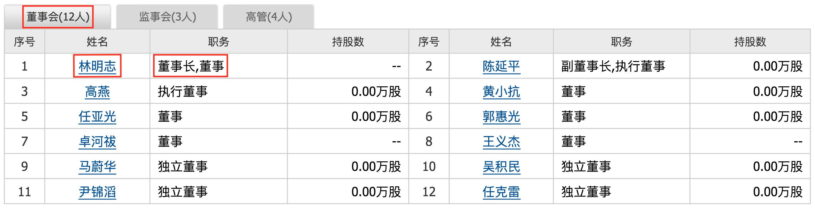
任务1：从网页中抽取董事会的信息
在抓取到的html文件中，需要对每一个股票/公司抽取董事会成员的信息
这部分信息包括董事会成员“姓名”、“职务”、“性别”、“年龄”共四个字段。
首先，姓名和职务的字段来自于：
在这里总共有12位董事成员的信息，都需要抽取出来.

Slide 9
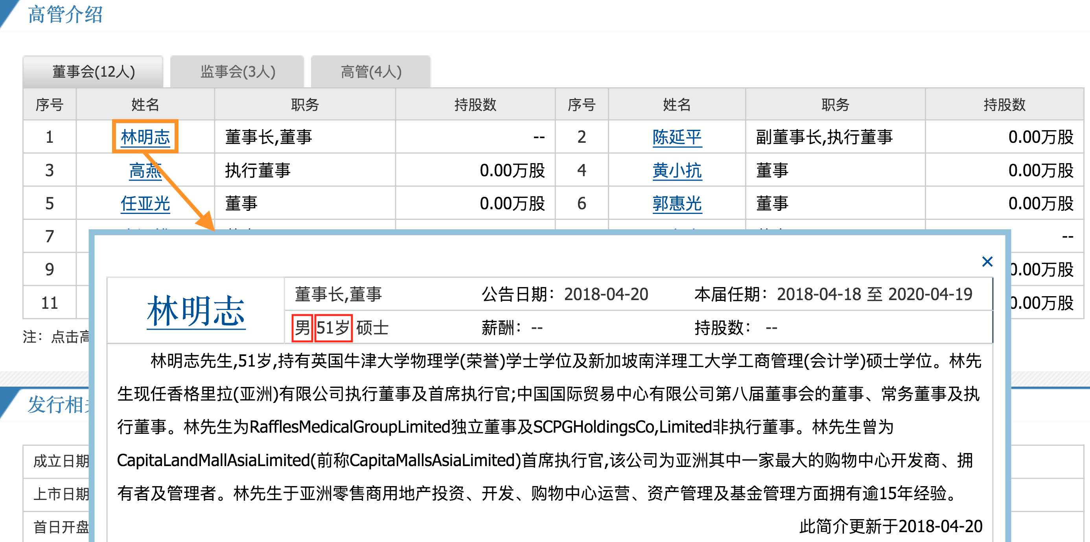
性别和年龄字段从下附图里抽取

Slide 10
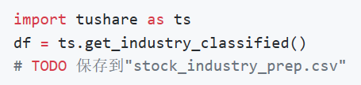
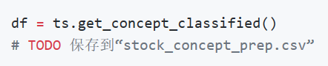
任务2：获取股票行业和概念的信息
对于这部分信息，我们可以利⽤工具Tushare来获取，官网为http://tushare.org/ ，使用pip命令进行安装即可。
下载完之后，在python里即可调用股票行业和概念信息。参考链接：http://tushare.org/classifying.html#id2
通过以下的代码即可获得股票行业信息，并把返回的信息直接存储在stock_industry_prep.csv文件里。
类似的，可以通过以下代码即可获得股票概念信息，并把它们存储在stock_concept_prep.csv文件里。

Slide 11
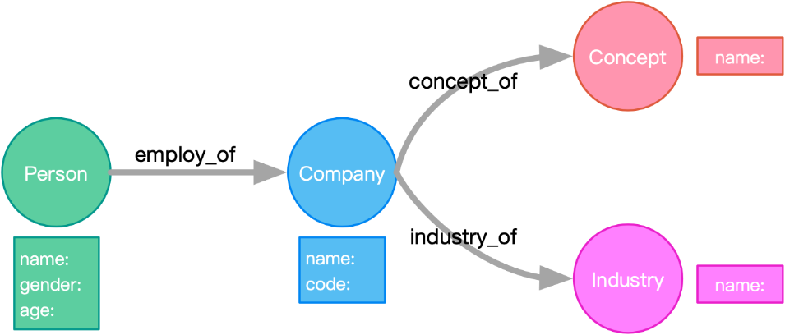
任务3：设计知识图谱
设计一个这样的图谱：
创建“人”实体，这个人拥有姓名、性别、年龄
创建“公司”实体，除了股票代码，还有股票名称
创建“概念”实体，每个概念都有概念名
创建“行业”实体，每个行业都有⾏业名
给“公司”实体添加“ST”的标记，这个由LABEL来实现
创建“人”和“公司”的关系，这个关系有董事长、执行董事等等
创建“公司”和“概念”的关系
创建“公司”和“行业”的关系

Slide 12
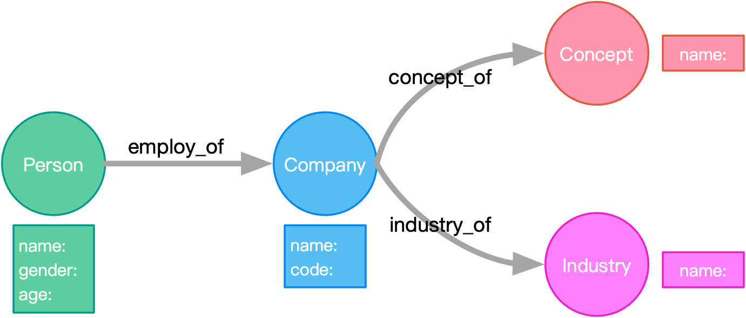
设计图
注：实体名字和关系名字需要易懂，对于上述的要求，并不一定存在唯一的设计，只要能够覆盖上面这些要求即可。“ST”标记是用来刻画⼀个股票严重亏损的状态，这个可以从给定的股票名字前缀来判断，背景知识可参考百科ST股票，“ST”股票对应列表为['*ST', 'ST', 'S*ST', 'SST']。

Slide 13
任务4：创建可以导⼊Neo4j的csv文件
在前两个任务里，分别生成了 executive_prep.csv, stock_industry_prep.csv, stock_concept_prep.csv，
但这些文件不能直接导入到Neo4j数据库。
需要做⼀些处理，并生成能够直接导入Neo4j的csv格式。
需要生成这⼏个文件：executive.csv, stock.csv, concept.csv, industry.csv, executive_stock.csv, stock_industry.csv, stock_concept.csv。
对于格式的要求，请参考：
https://neo4j.com/docs/operations-manual/current/tutorial/import-tool/

Slide 14
任务5：利用上面的csv文件生成数据库
neo4j_home$ bin/neo4j-admin import --nodes executive.csv --nodes stock.csv -- nodes concept.csv --nodes industry.csv --relationships executive_stock.csv --relationships stock_industry.csv -- relationships stock_concept.csv
这个命令会把所有的数据导入到Neo4j中，数据默认存放在 graph.db 文件夹里。如果graph.db文件夹之前已经有数据存在，则可以选择先删除再执行命令。
把Neo4j服务重启之后，就可以通过localhost:7474观察到知识图谱了。

Slide 15
任务6：基于构建好的知识图谱，通过编写Cypher语句回答如下问题
(1) 有多少个公司目前是属于“ST”类型的？
(2) “600519”公司的所有独立董事人员中，有多少人同时也担任别的公司的独立董事职位？
(3) 有多少公司既属于环保行业，又有外资背景？
(4) 对于有锂电池概念的所有公司，独⽴董事中女性⼈员⽐例是多少？

Slide 16
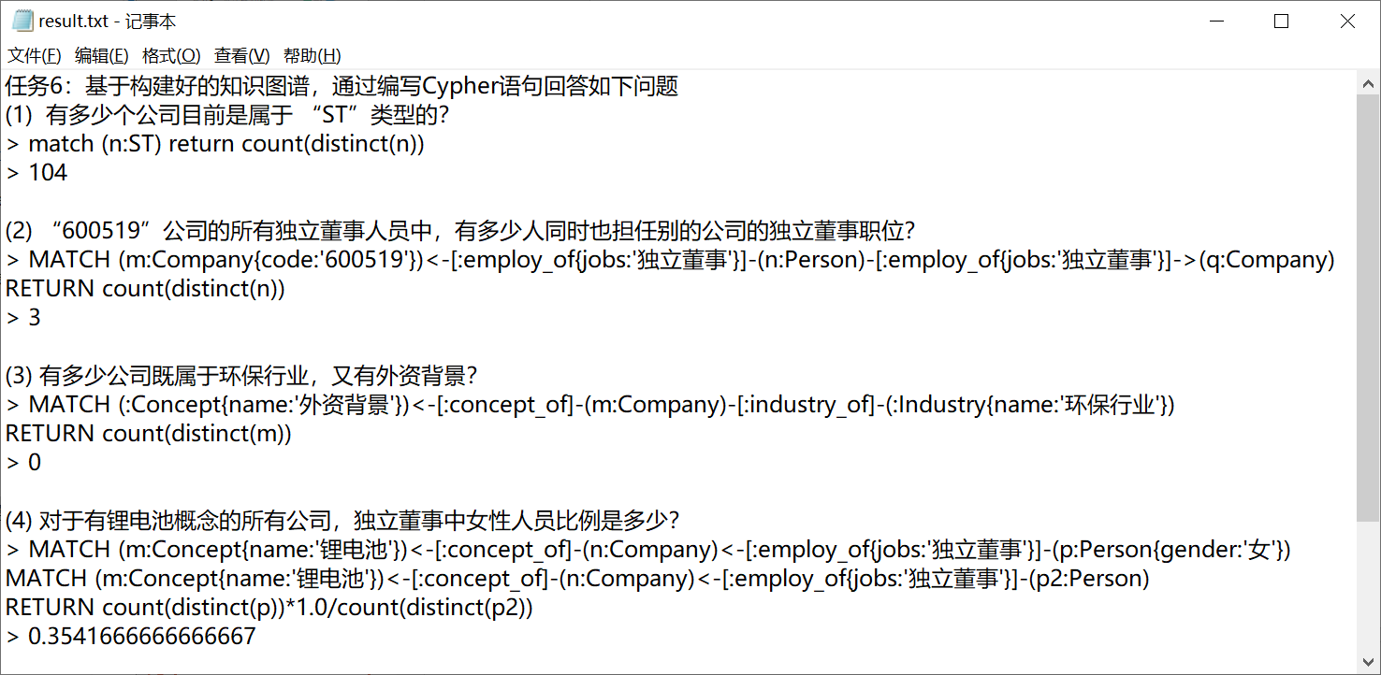
Notes:
(1) 有多少个公司目前是属于 “ST”类型的？
> match (n:ST) return count(distinct(n))
> 104
(2) “600519”公司的所有独立董事人员中，有多少人同时也担任别的公司的独立董事职位？
> MATCH (m:Company{code:'600519'})<-[:employ_of{jobs:'独立董事'}]-(n:Person)-[:employ_of{jobs:'独立董事'}]->(q:Company)
RETURN count(distinct(n))
> 3
(3) 有多少公司既属于环保行业，又有外资背景？
> MATCH (:Concept{name:'外资背景'})<-[:concept_of]-(m:Company)-[:industry_of]-(:Industry{name:'环保行业'})
RETURN count(distinct(m))
> 0
(4) 对于有锂电池概念的所有公司，独立董事中女性人员比例是多少？
> MATCH (m:Concept{name:'锂电池'})<-[:concept_of]-(n:Company)<-[:employ_of{jobs:'独立董事'}]-(p:Person{gender:'女'})
MATCH (m:Concept{name:'锂电池'})<-[:concept_of]-(n:Company)<-[:employ_of{jobs:'独立董事'}]-(p2:Person)
RETURN count(distinct(p))*1.0/count(distinct(p2))
> 0.3541666666666667

Slide 17
任务7：构建人的实体时，重名问题具体怎么解决？
最好的方式是用身份证或者其他唯一能确定人的方式去关联。
在本例中，用 姓名、年龄、性别3个字段做唯一的，将这3个字段做md5。

Slide 18
补充：抓取网页 by Hongfei Yan

Slide 19
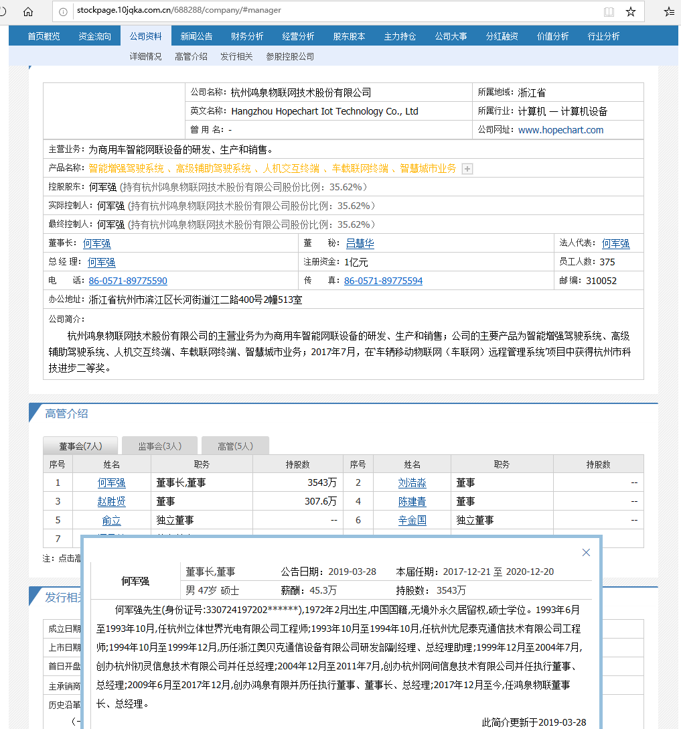

Slide 20
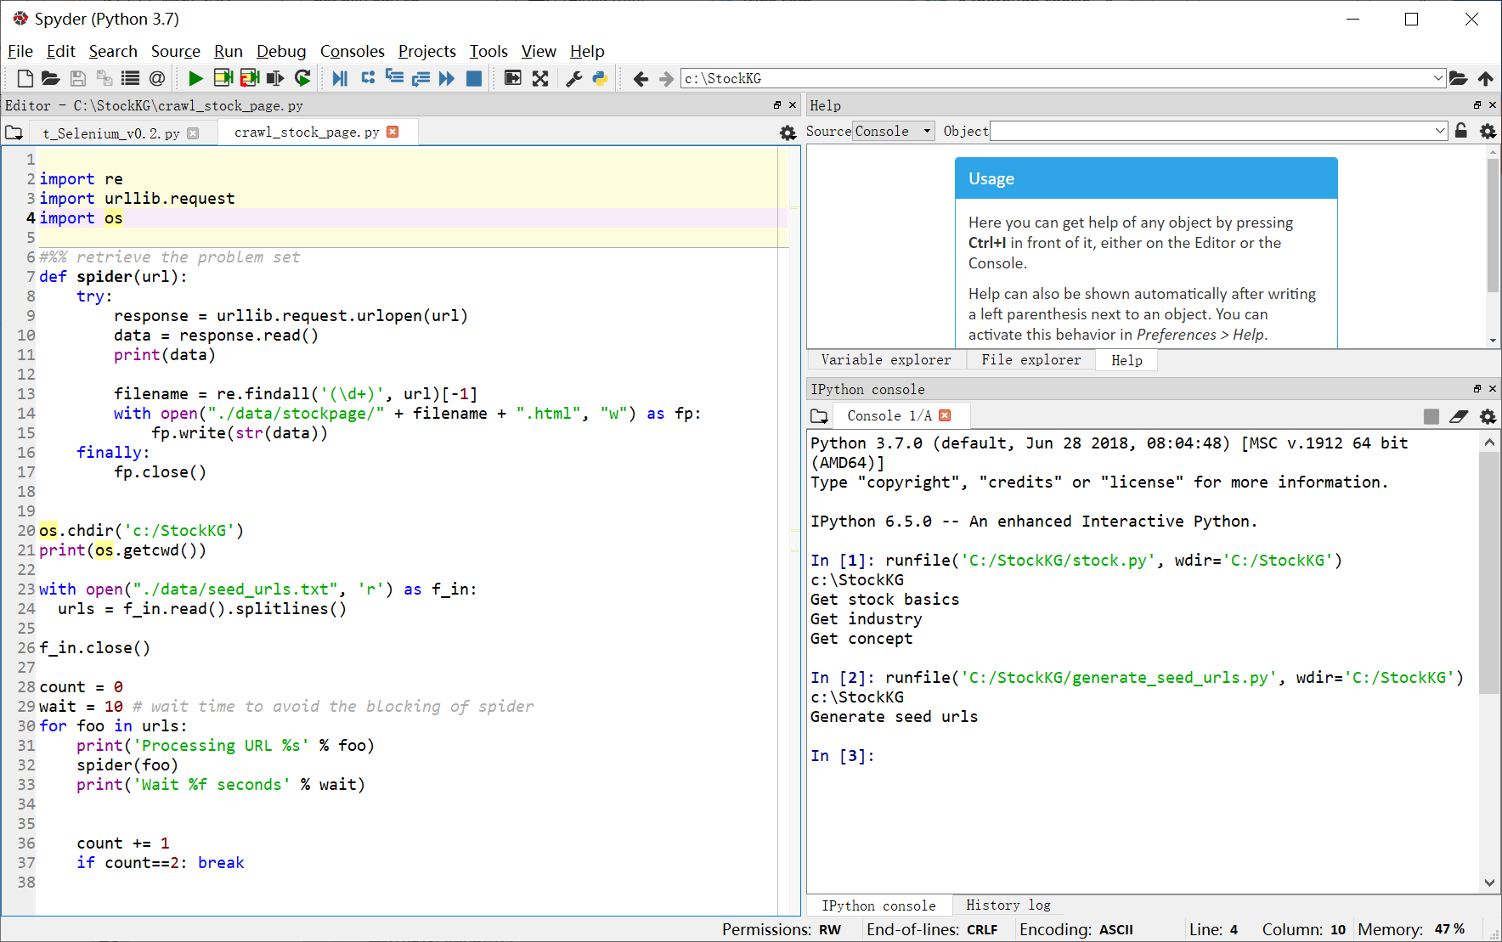
Notes:
import re
import urllib.request
import os
#%% retrieve the problem set
def spider(url):
try:
response = urllib.request.urlopen(url)
data = response.read()
print(data)
filename = re.findall('(\d+)', url)[-1]
with open("./data/stockpage/" + filename + ".html", "w") as fp:
fp.write(str(data))
finally:
fp.close()
os.chdir('c:/StockKG')
print(os.getcwd())
with open("./data/seed_urls.txt", 'r') as f_in:
urls = f_in.read().splitlines()
f_in.close()
count = 0
wait = 10 # wait time to avoid the blocking of spider
for foo in urls:
print('Processing URL %s' % foo)
spider(foo)
print('Wait %f seconds' % wait)
count += 1
if count==2: break

Slide 21
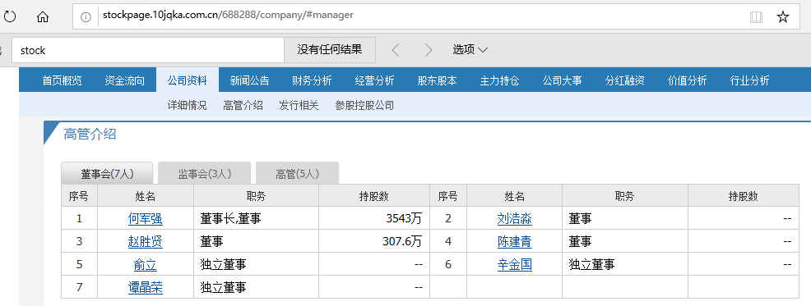
Q: 我想要网页源文，只返回 b'‘
A: 加个headers即可。headers可以用fiddler抓取。

Slide 22
用到软件
FiddlerSetup.exe 6.5MB

Slide 23
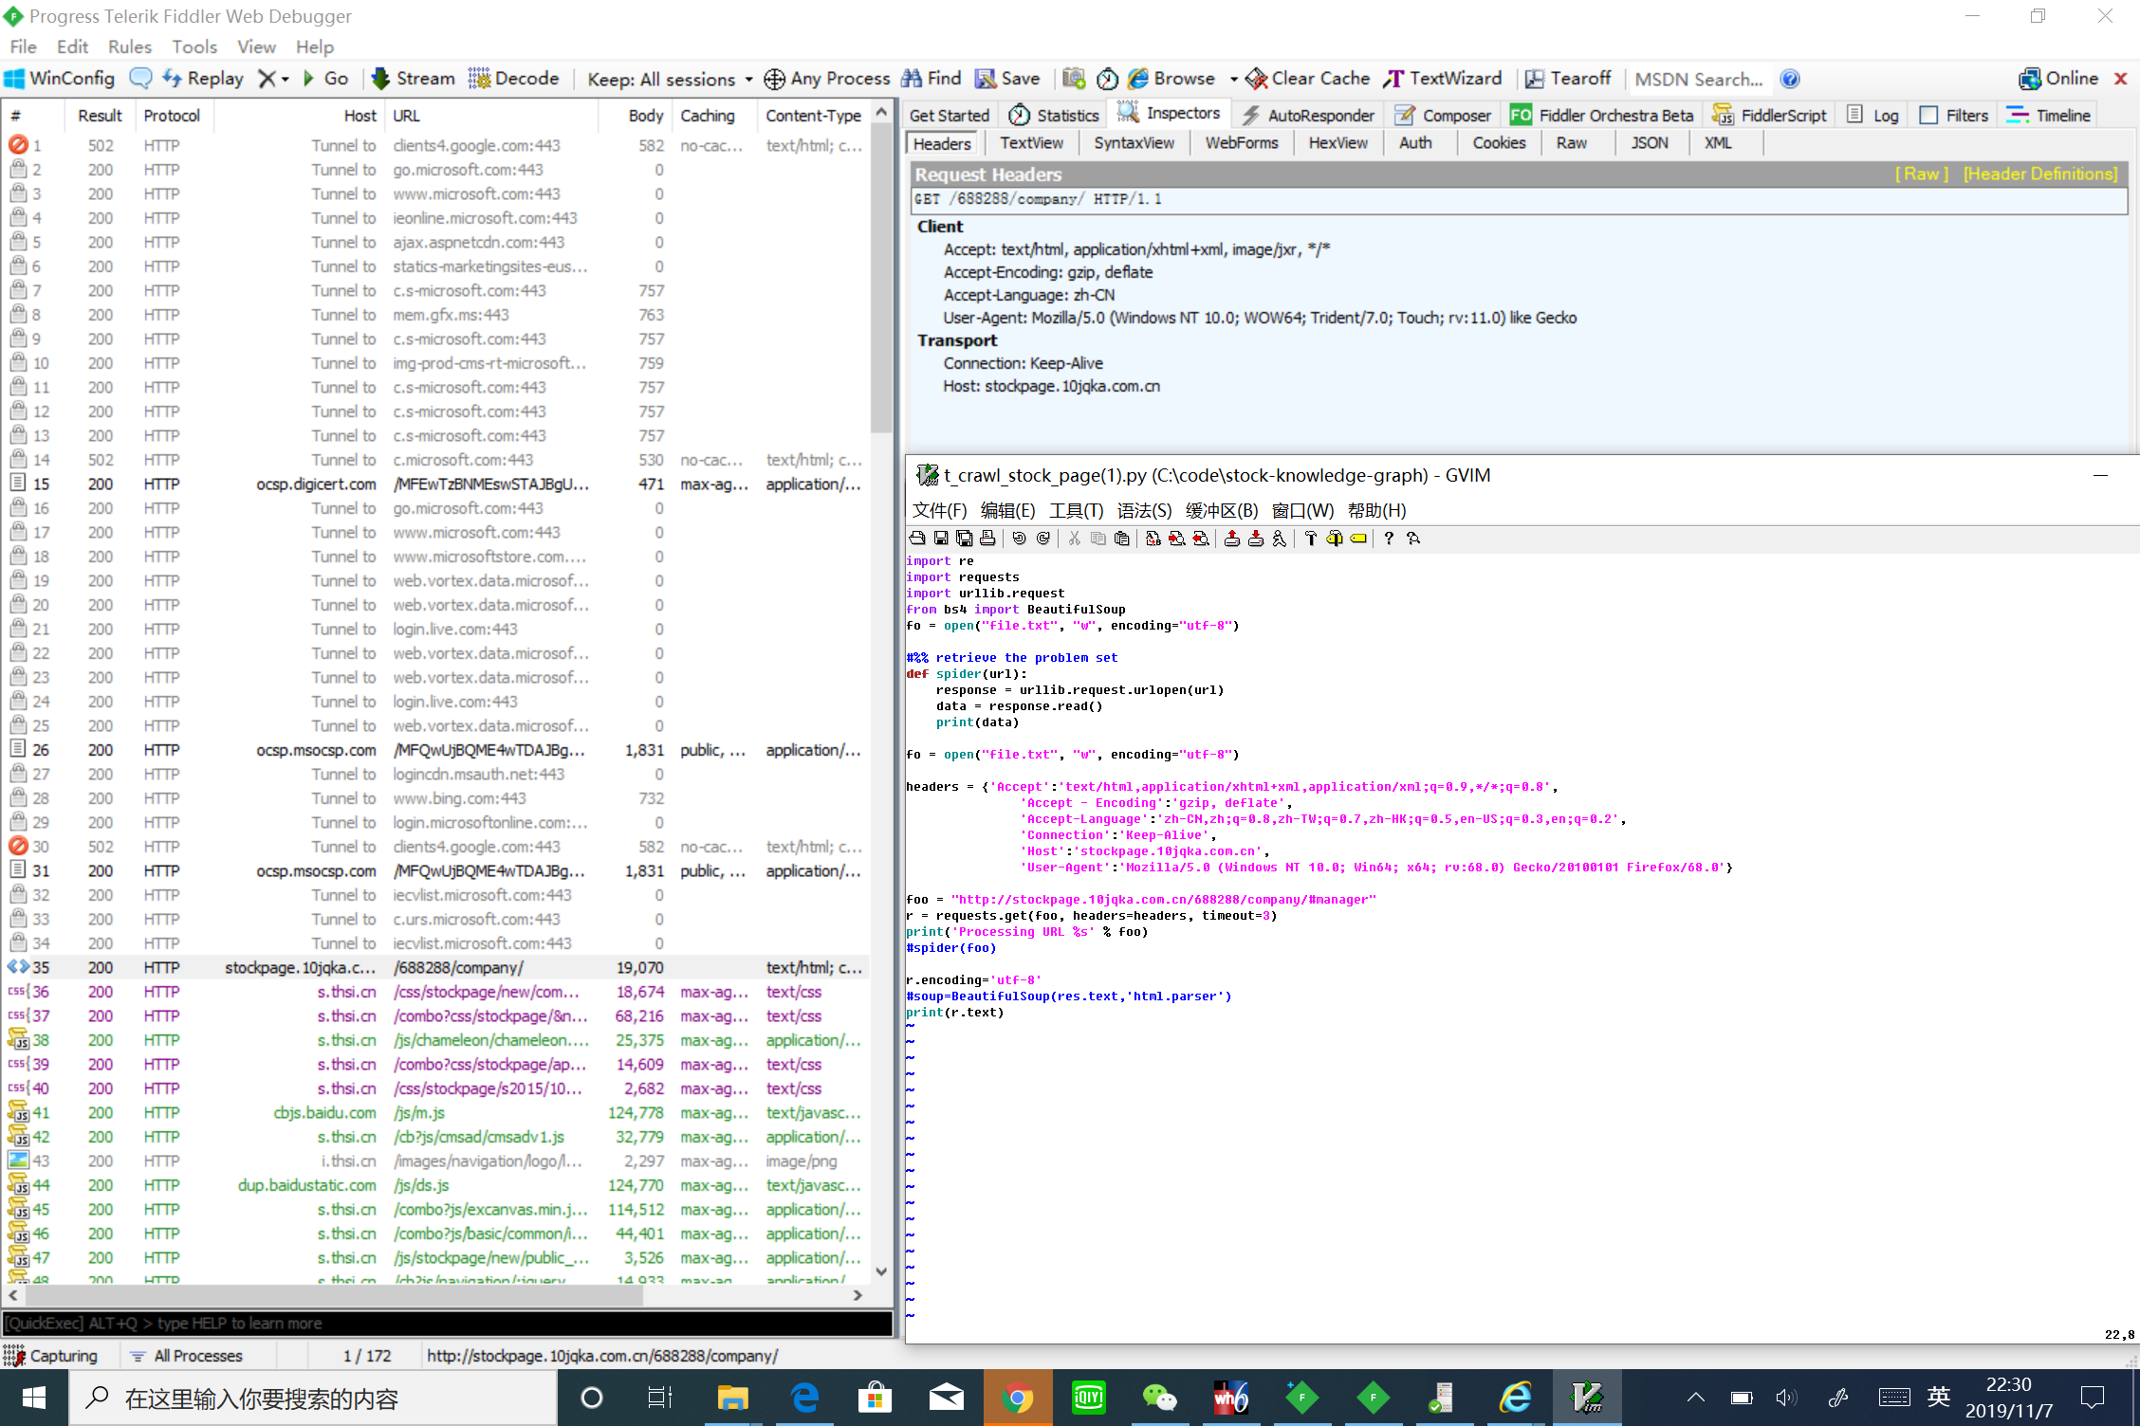

Slide 24
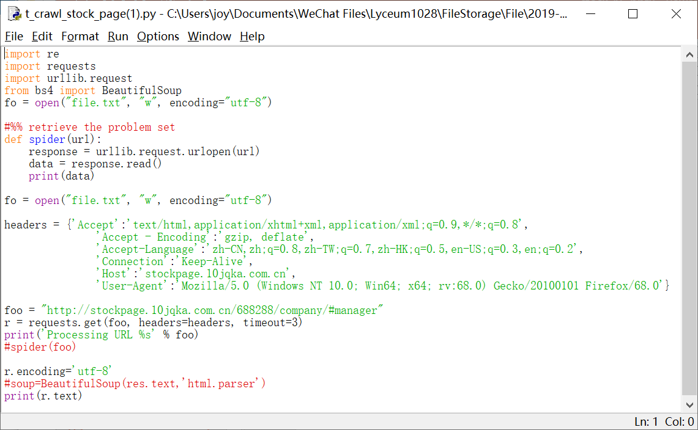

Slide 25
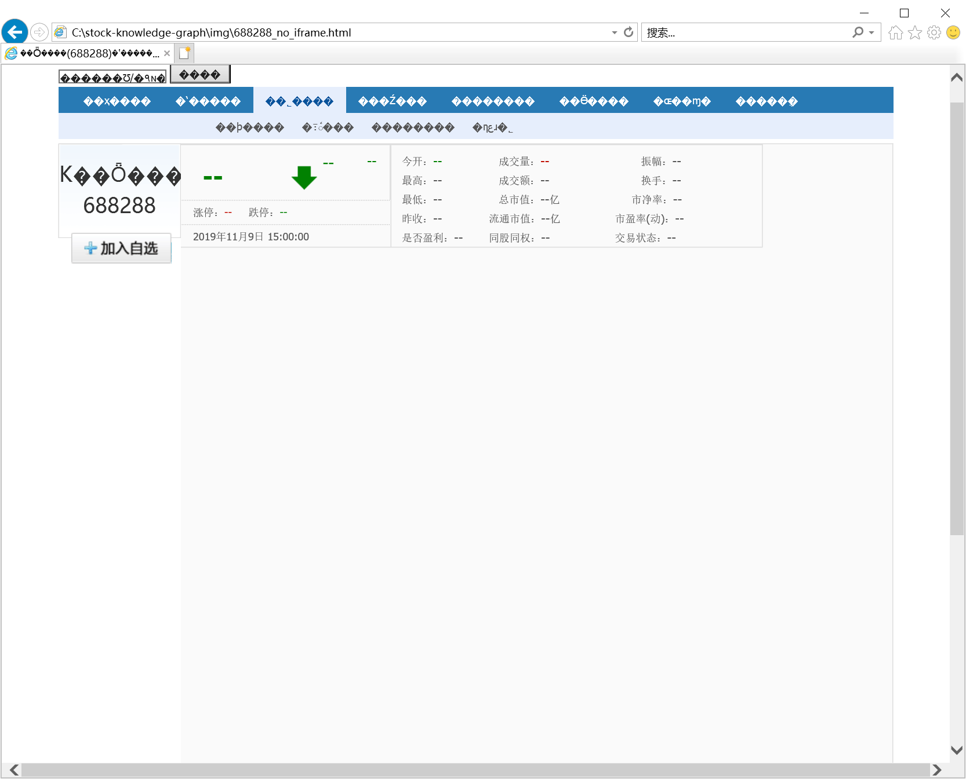

Slide 26
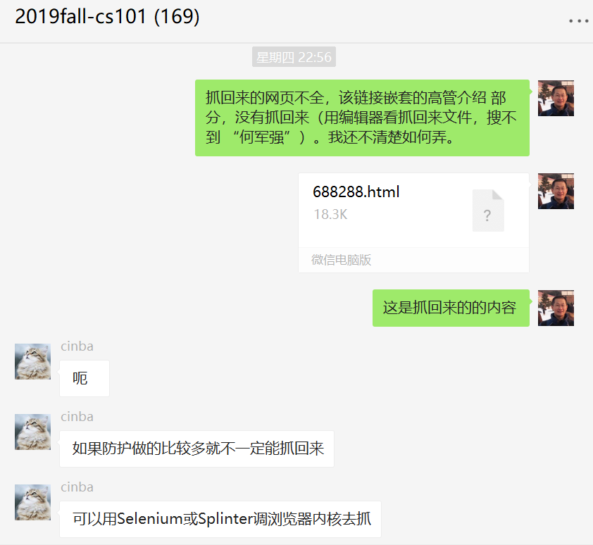

Slide 27
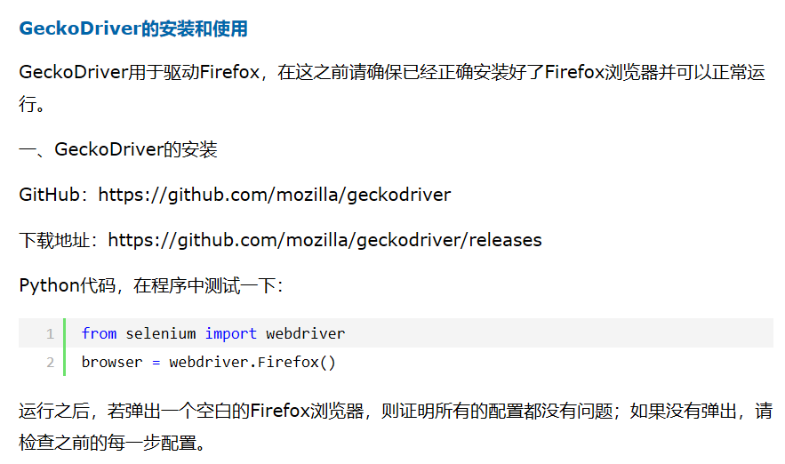
Selenium库，geckodriver驱动Firefox
conda-forge / packages / selenium 3.141.0,
https://anaconda.org/conda-forge/selenium
conda install -c conda-forge selenium
https://github.com/mozilla/geckodriver/releases
下载的geckodriver-v0.26.0-win64.zip，15MB
解开得到geckodriver.exe，
拷贝到C:\Anaconda3目录
Notes:
conda连接https://mirrors.tuna.tsinghua.edu.cn/，速度快

Slide 28
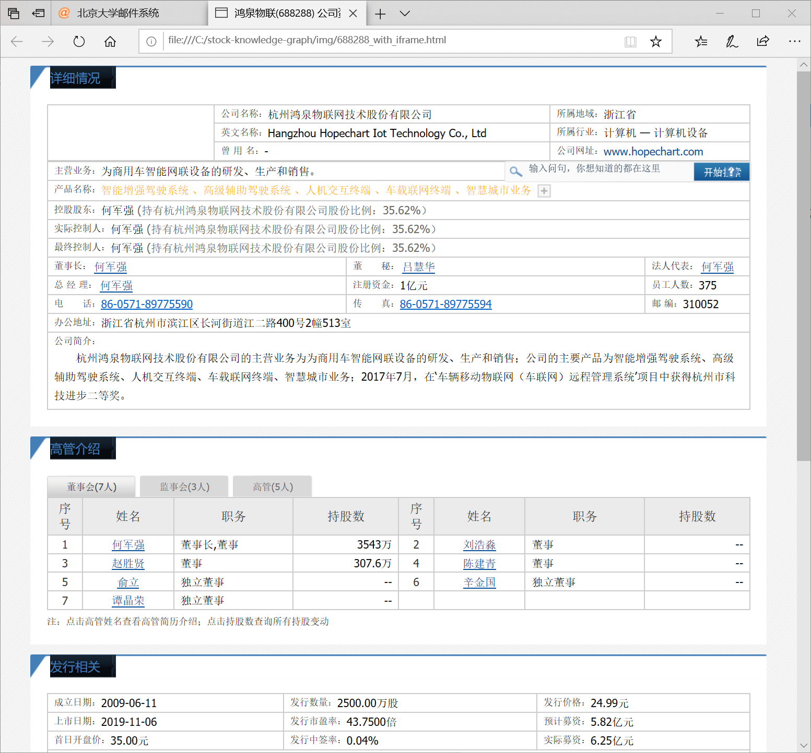

Slide 29
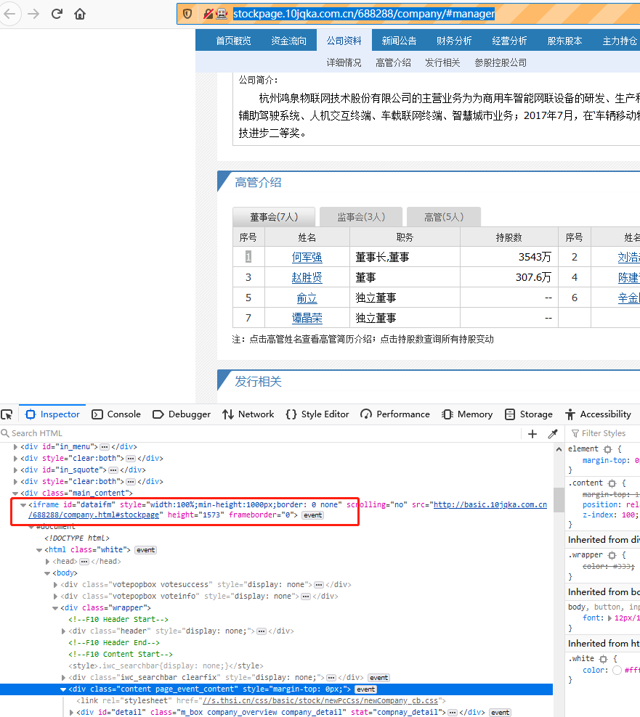

Slide 30
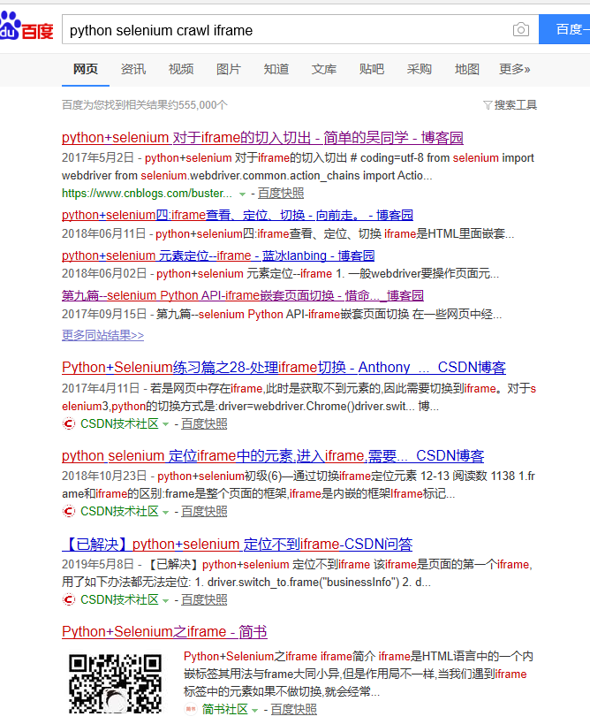

Slide 31
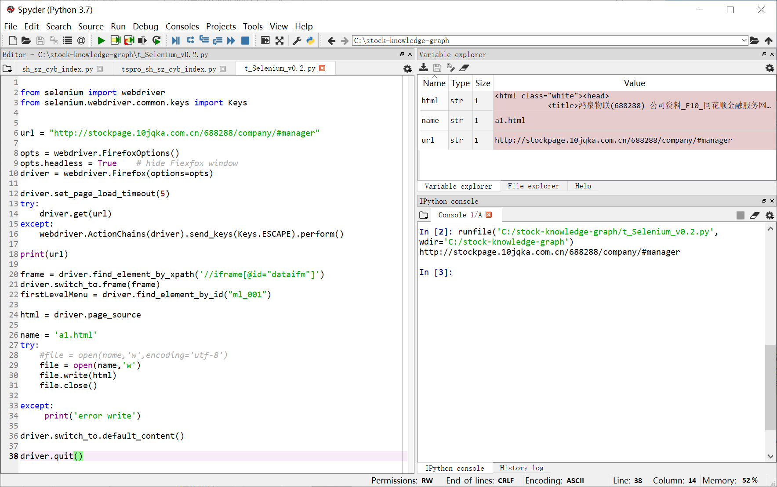

Slide 32
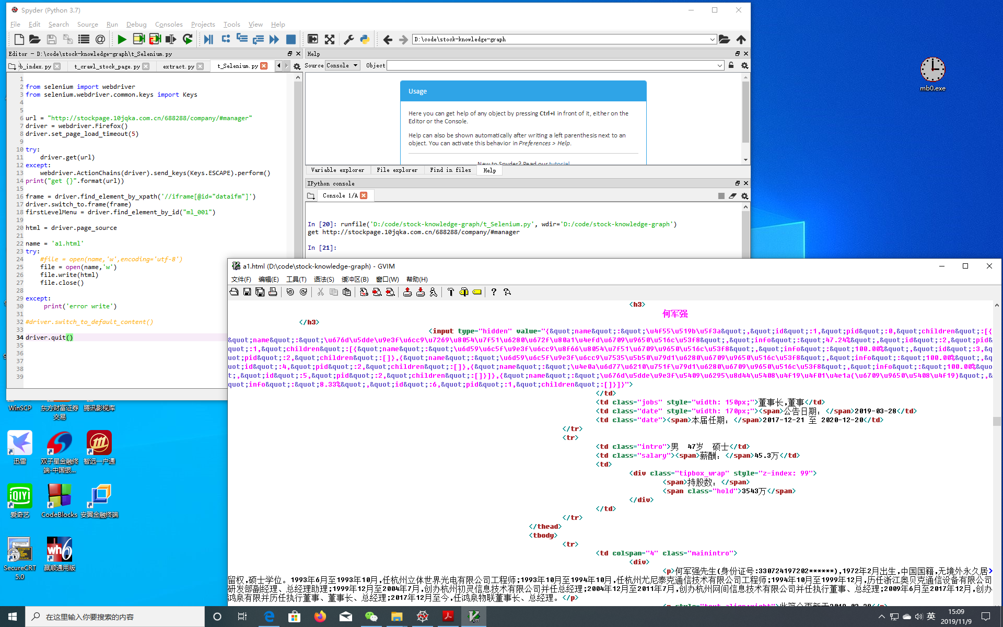

Slide 33
单个带iframe的网页可以抓回来了
开始整个mini project的运行

Slide 34
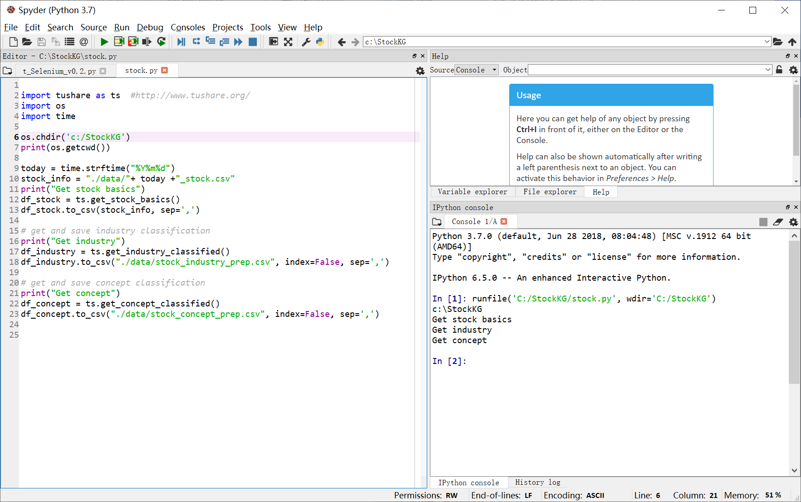

Notes:
import tushare as ts #http://www.tushare.org/
import os
import time
os.chdir('c:/StockKG')
print(os.getcwd())
today = time.strftime("%Y%m%d")
stock_info = "./data/"+ today +"_stock.csv"
print("Get stock basics")
df_stock = ts.get_stock_basics()
df_stock.to_csv(stock_info, sep=',')
# get and save industry classification
print("Get industry")
df_industry = ts.get_industry_classified()
df_industry.to_csv("./data/stock_industry_prep.csv", index=False, sep=',')
# get and save concept classification
print("Get concept")
df_concept = ts.get_concept_classified()
df_concept.to_csv("./data/stock_concept_prep.csv", index=False, sep=',')

Slide 35
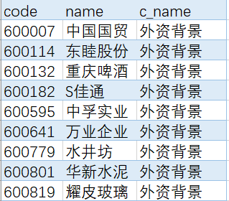
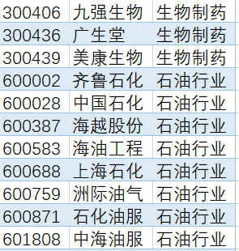
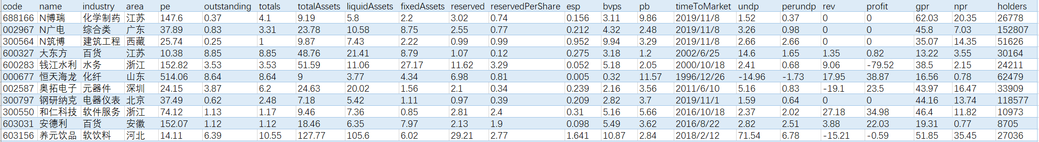
stock_concept_prep.csv
stock_industry_prep.csv
20191110_stock.csv

Slide 36
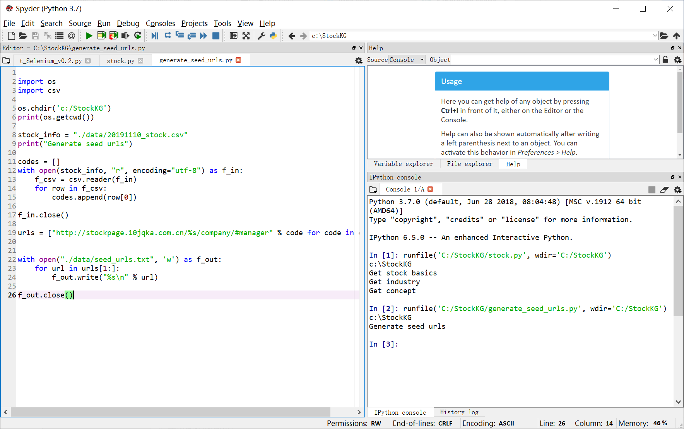
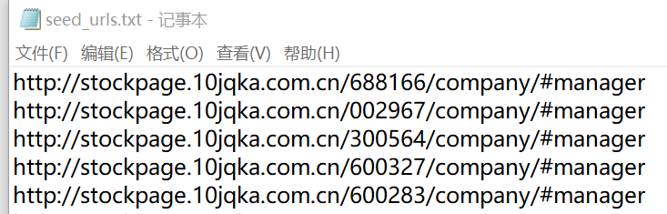
Notes:
import os
import csv
os.chdir('c:/StockKG')
print(os.getcwd())
stock_info = "./data/20191110_stock.csv"
print("Generate seed urls")
codes = []
with open(stock_info, "r", encoding="utf-8") as f_in:
f_csv = csv.reader(f_in)
for row in f_csv:
codes.append(row[0])
f_in.close()
urls = ["http://stockpage.10jqka.com.cn/%s/company/#manager" % code for code in codes]
with open("./data/seed_urls.txt", 'w') as f_out:
for url in urls[1:]:
f_out.write("%s\n" % url)
f_out.close()

Slide 37
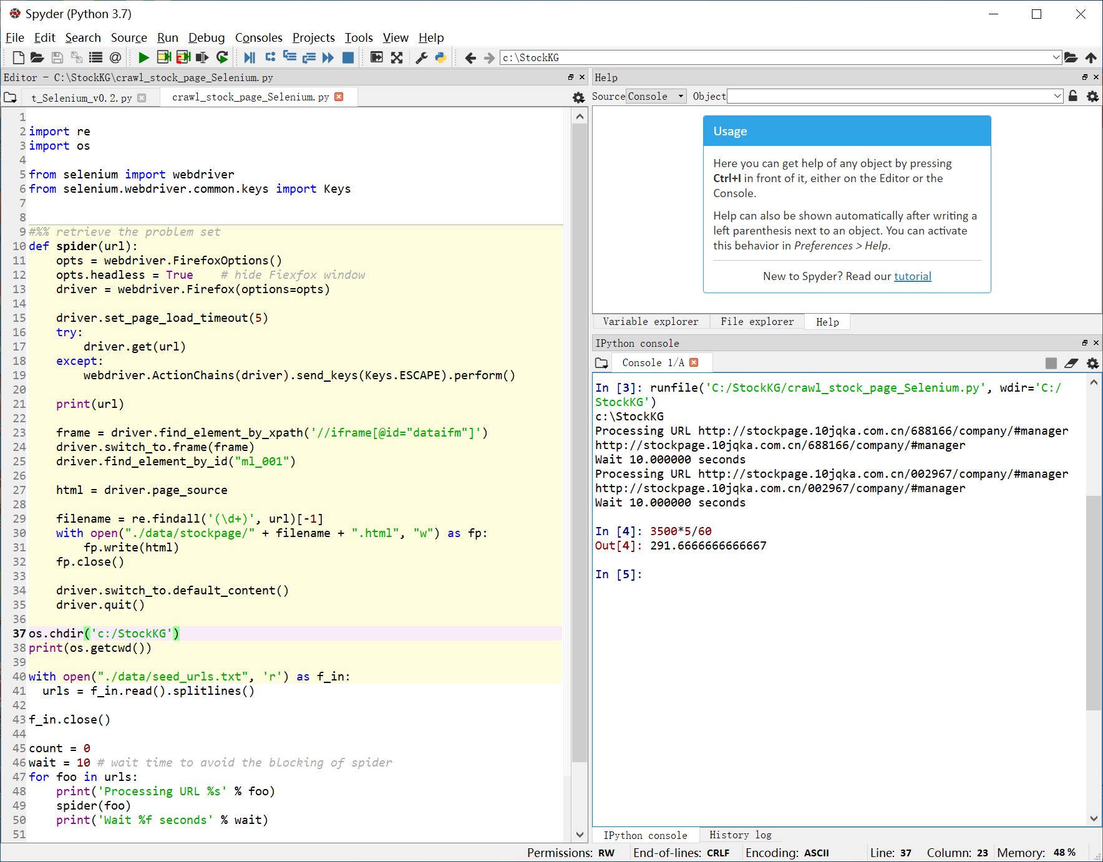
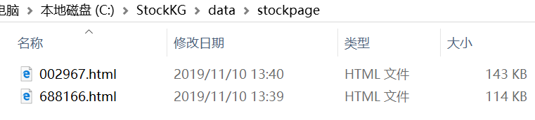
Notes:
import re
import os
from selenium import webdriver
from selenium.webdriver.common.keys import Keys
#%% retrieve the problem set
def spider(url):
opts = webdriver.FirefoxOptions()
opts.headless = True # hide Fiexfox window
driver = webdriver.Firefox(options=opts)
driver.set_page_load_timeout(5)
try:
driver.get(url)
except:
webdriver.ActionChains(driver).send_keys(Keys.ESCAPE).perform()
print(url)
frame = driver.find_element_by_xpath('//iframe[@id="dataifm"]')
driver.switch_to.frame(frame)
driver.find_element_by_id("ml_001")
html = driver.page_source
filename = re.findall('(\d+)', url)[-1]
with open("./data/stockpage/" + filename + ".html", "w") as fp:
fp.write(html)
fp.close()
driver.switch_to.default_content()
driver.quit()
os.chdir('c:/StockKG')
print(os.getcwd())
with open("./data/seed_urls.txt", 'r') as f_in:
urls = f_in.read().splitlines()
f_in.close()
count = 0
wait = 10 # wait time to avoid the blocking of spider
for foo in urls:
print('Processing URL %s' % foo)
spider(foo)
print('Wait %f seconds' % wait)
count += 1
if count==2: break

Slide 38
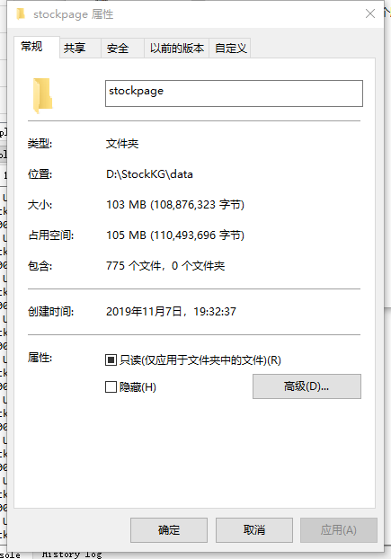
抓取4个小时，加了延时，避免封爬虫
4个小时抓了775个网页，还在继续。机器开着，我下班了。

Slide 39
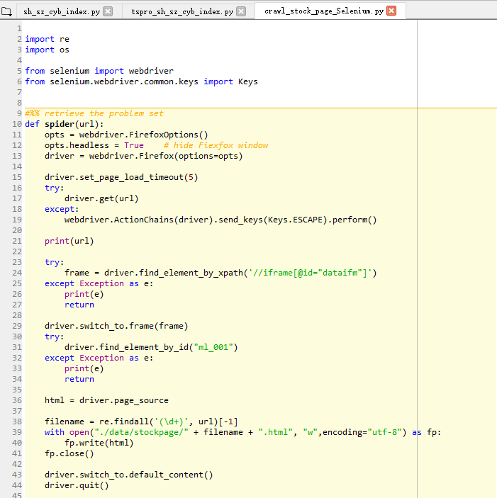
实际做个小项目，任何一条语句都可能返回错误的，看图上那些try... except。 Codeforces上面的题目，测试数据是相当友好的了。

Slide 40
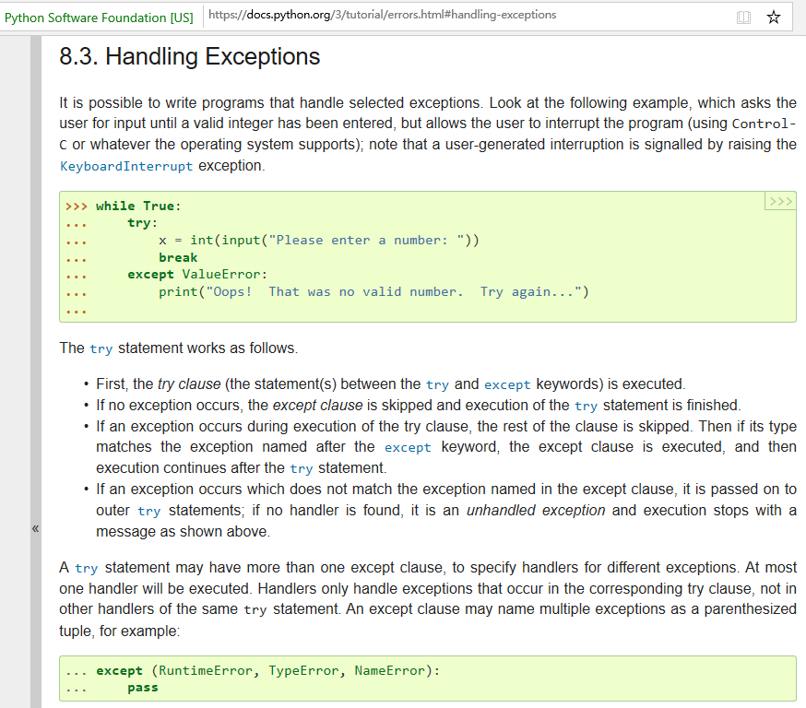

Slide 41
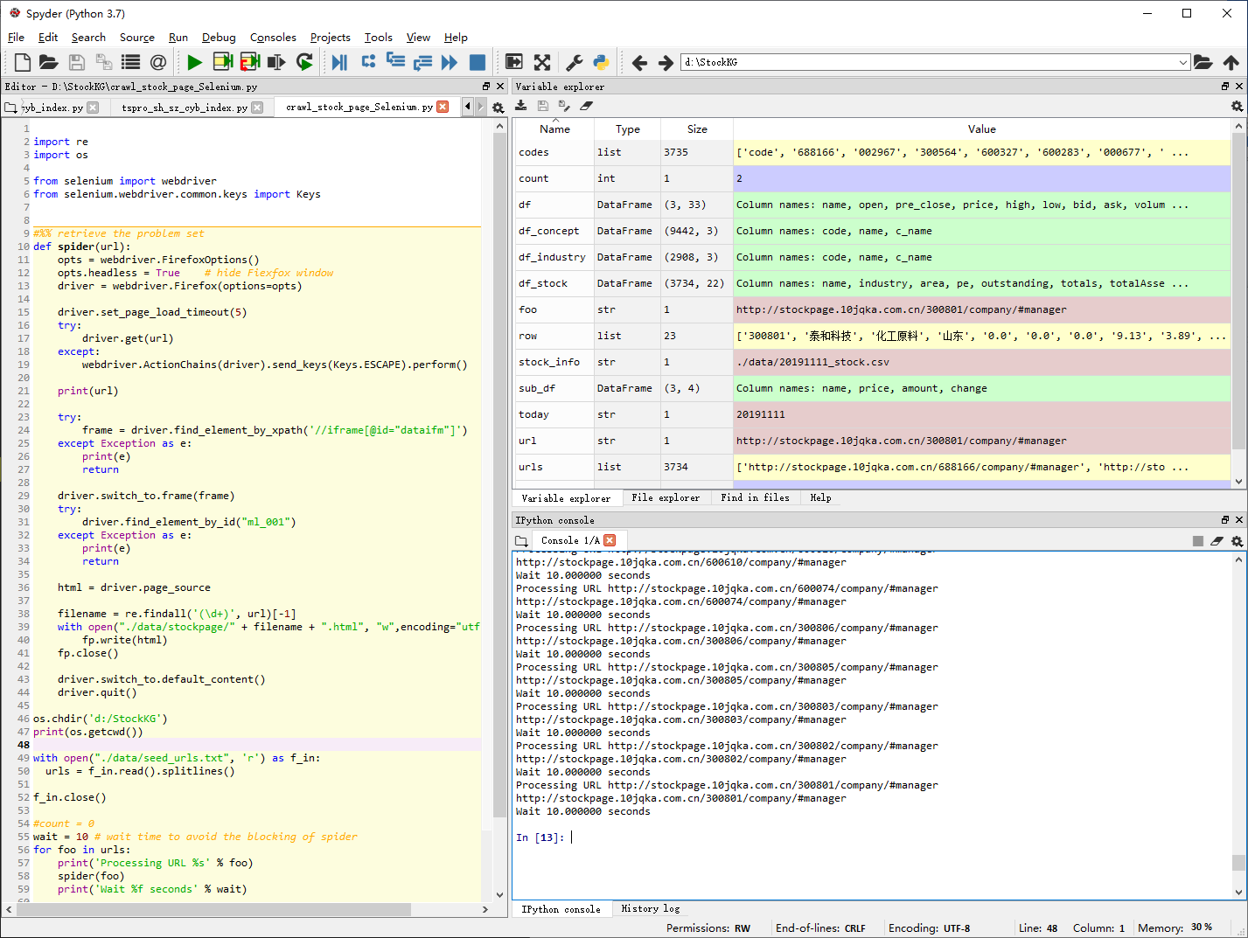

Slide 42
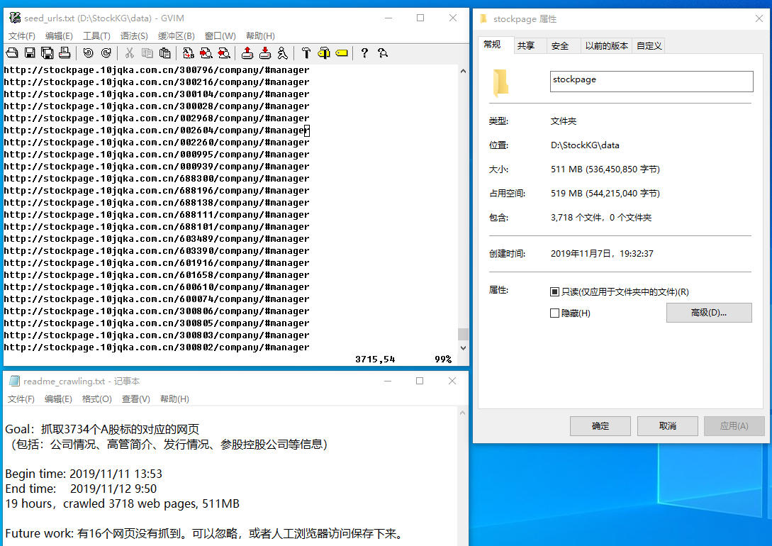

Slide 43
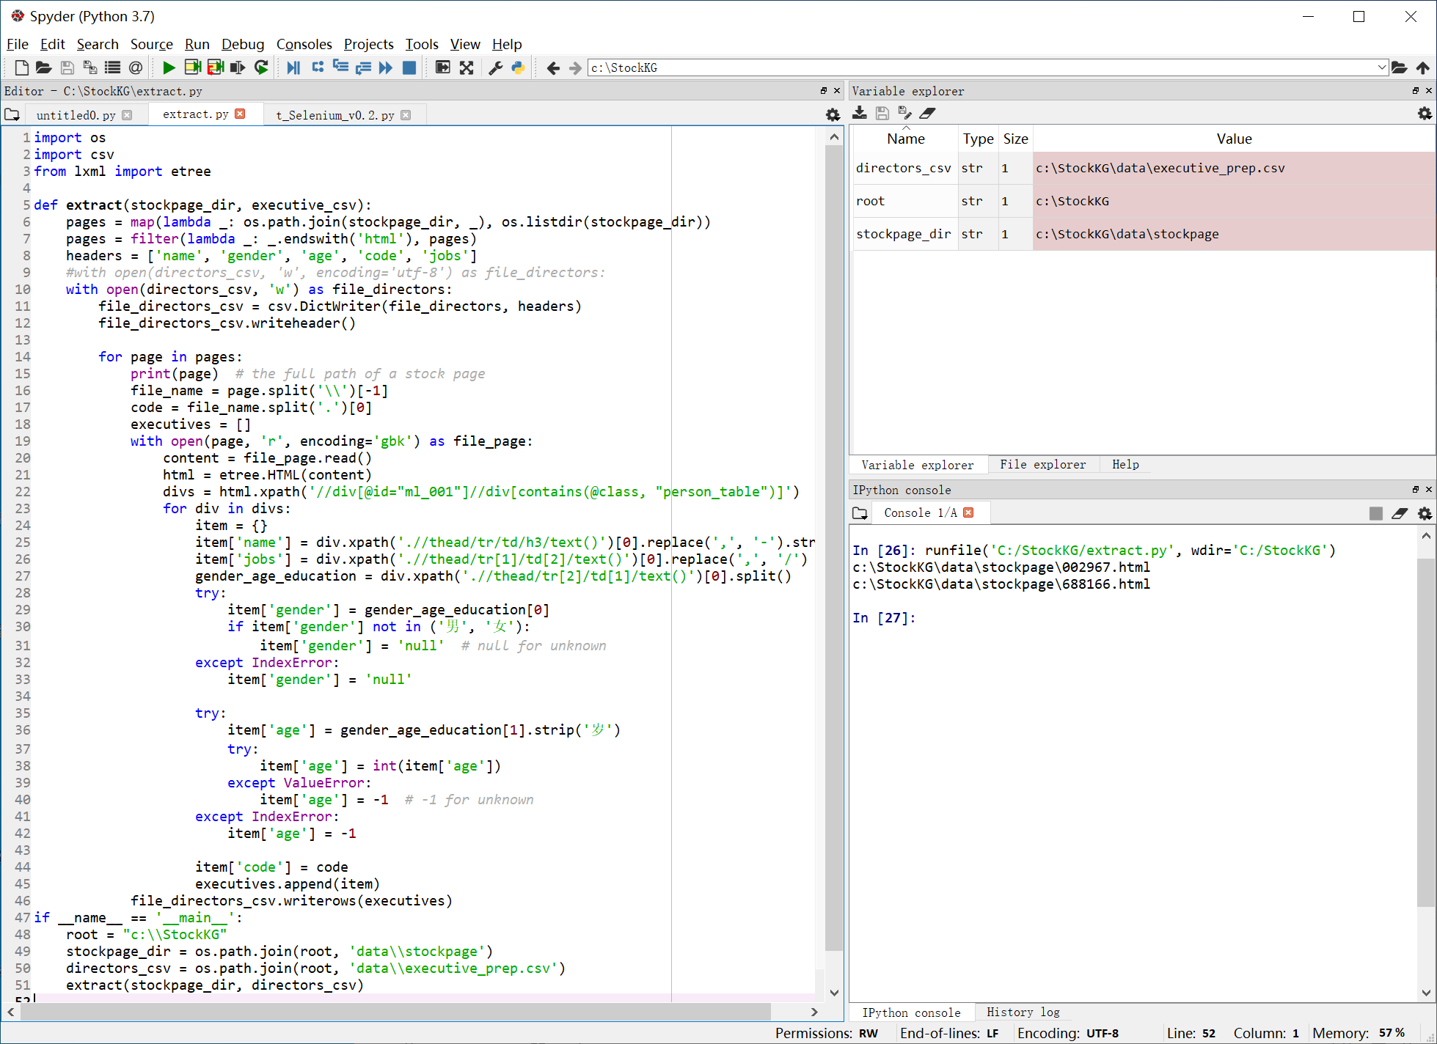
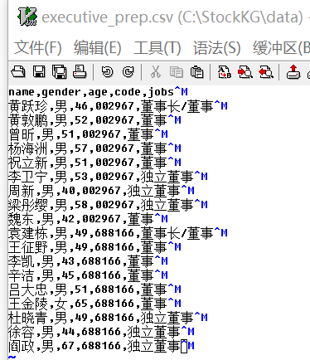
Notes:
import os
import csv
from lxml import etree
def extract(stockpage_dir, executive_csv):
pages = map(lambda _: os.path.join(stockpage_dir, _), os.listdir(stockpage_dir))
pages = filter(lambda _: _.endswith('html'), pages)
headers = ['name', 'gender', 'age', 'code', 'jobs']
#with open(directors_csv, 'w', encoding='utf-8') as file_directors:
with open(directors_csv, 'w') as file_directors:
file_directors_csv = csv.DictWriter(file_directors, headers)
file_directors_csv.writeheader()
for page in pages:
print(page) # the full path of a stock page
file_name = page.split('\\')[-1]
code = file_name.split('.')[0]
executives = []
with open(page, 'r', encoding='gbk') as file_page:
content = file_page.read()
html = etree.HTML(content)
divs = html.xpath('//div[@id="ml_001"]//div[contains(@class, "person_table")]')
for div in divs:
item = {}
item['name'] = div.xpath('.//thead/tr/td/h3/text()')[0].replace(',', '-').strip()
item['jobs'] = div.xpath('.//thead/tr[1]/td[2]/text()')[0].replace(',', '/')
gender_age_education = div.xpath('.//thead/tr[2]/td[1]/text()')[0].split()
try:
item['gender'] = gender_age_education[0]
if item['gender'] not in ('男', '女'):
item['gender'] = 'null' # null for unknown
except IndexError:
item['gender'] = 'null'
try:
item['age'] = gender_age_education[1].strip('岁')
try:
item['age'] = int(item['age'])
except ValueError:
item['age'] = -1 # -1 for unknown
except IndexError:
item['age'] = -1
item['code'] = code
executives.append(item)
file_directors_csv.writerows(executives)
if __name__ == '__main__':
root = "c:\\StockKG"
stockpage_dir = os.path.join(root, 'data\\stockpage')
directors_csv = os.path.join(root, 'data\\executive_prep.csv')
extract(stockpage_dir, directors_csv)

Slide 44
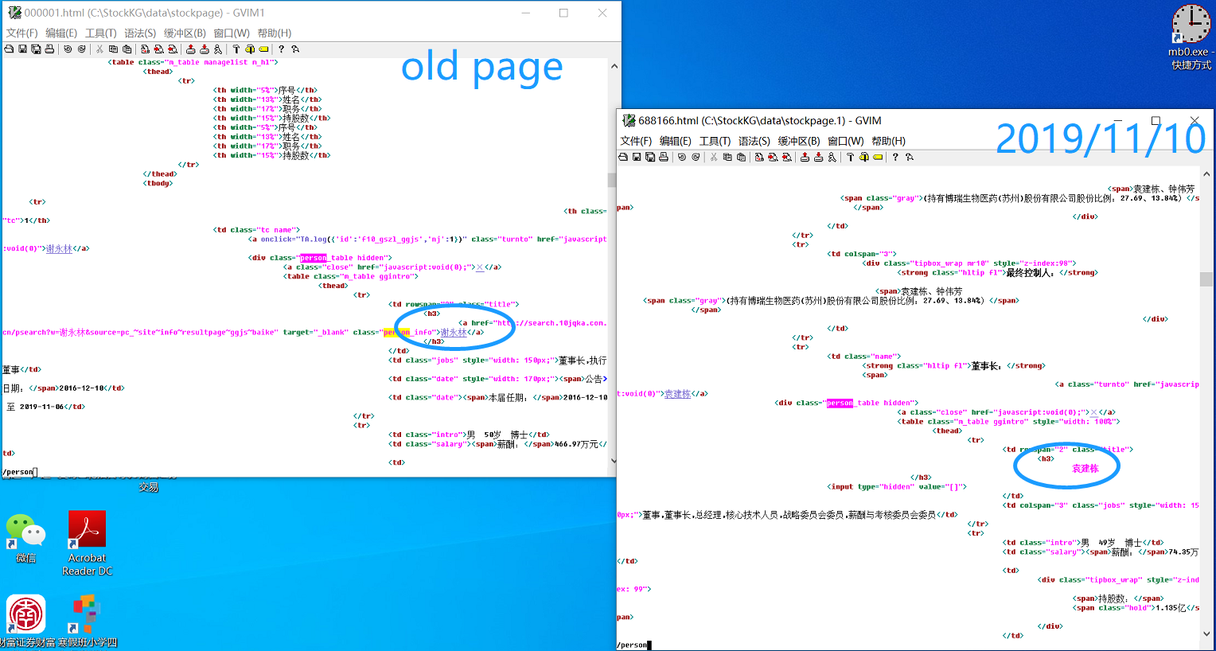


Slide 45
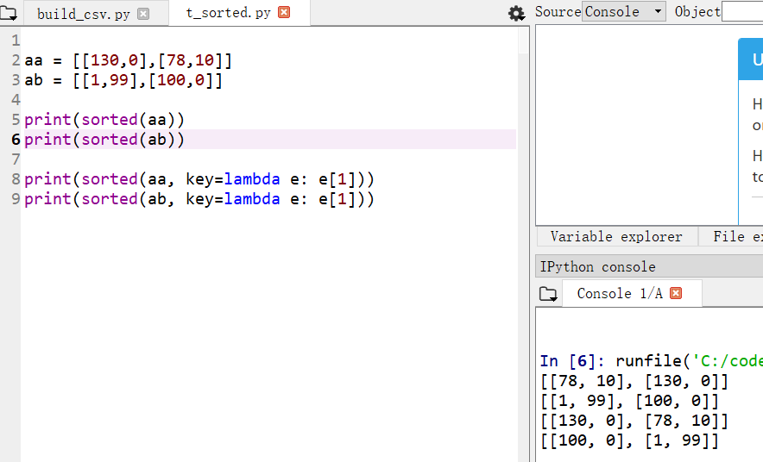
按第0项或者第1项排序
sorted默认是对第一项排序，如果第二项，sorted( iterable, key = lamda e: e[1])

Slide 46
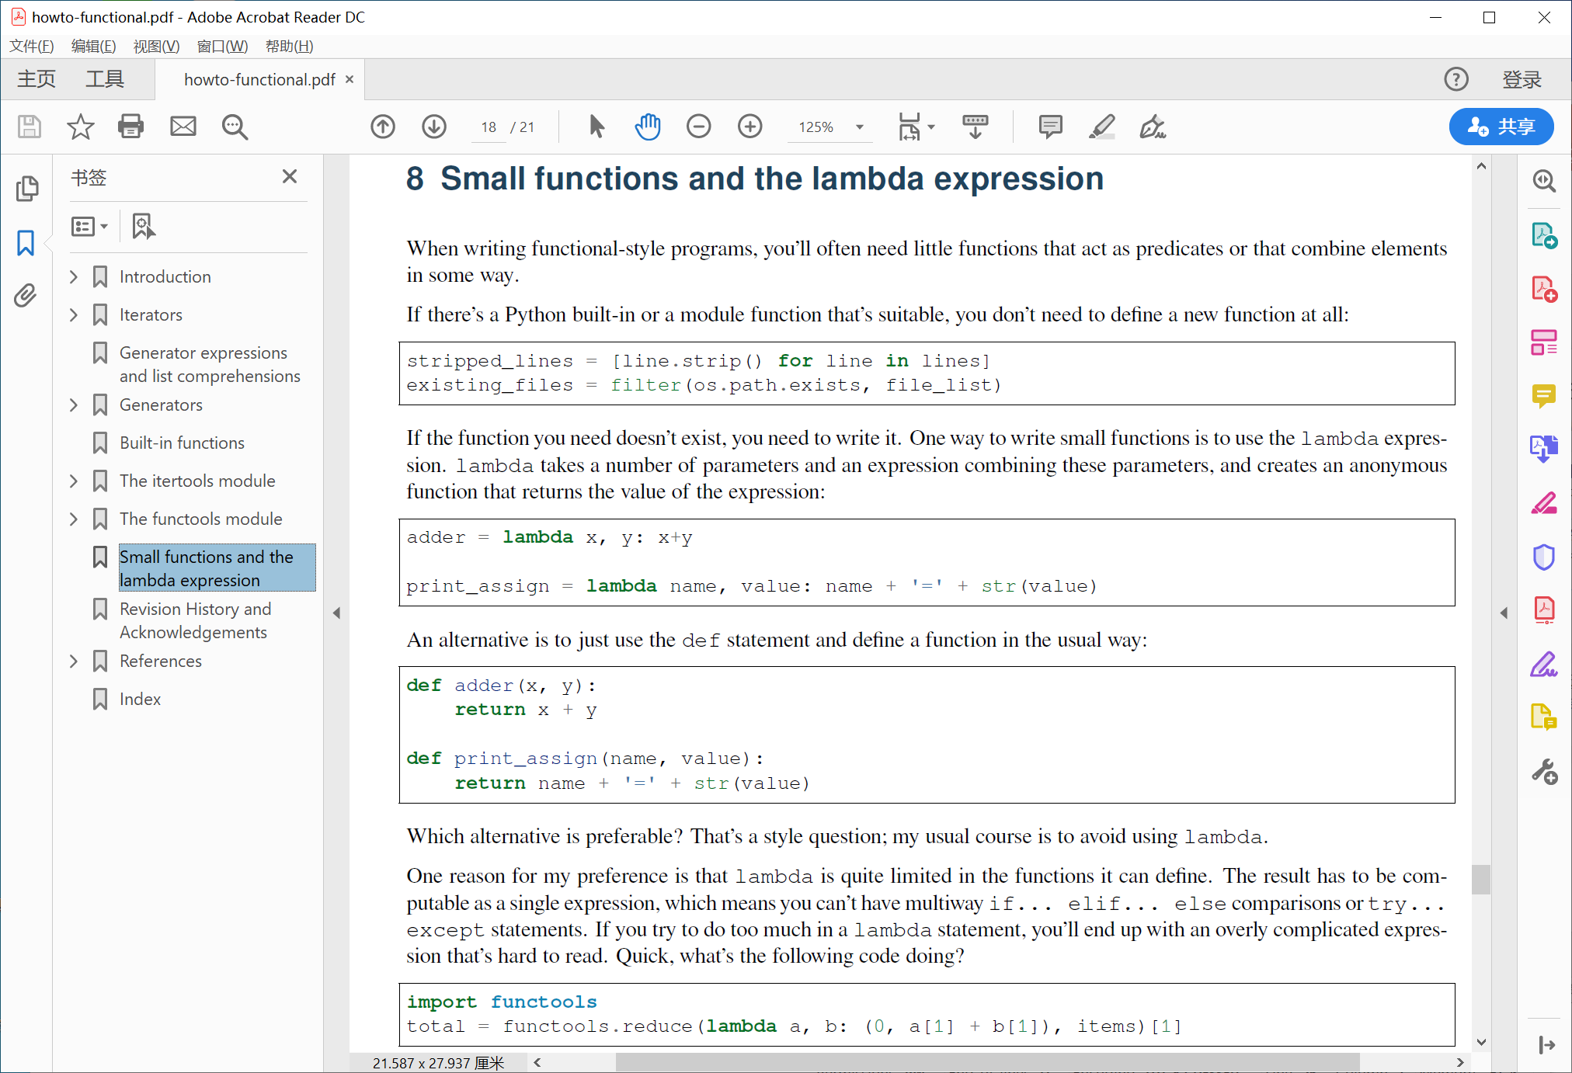

Slide 47
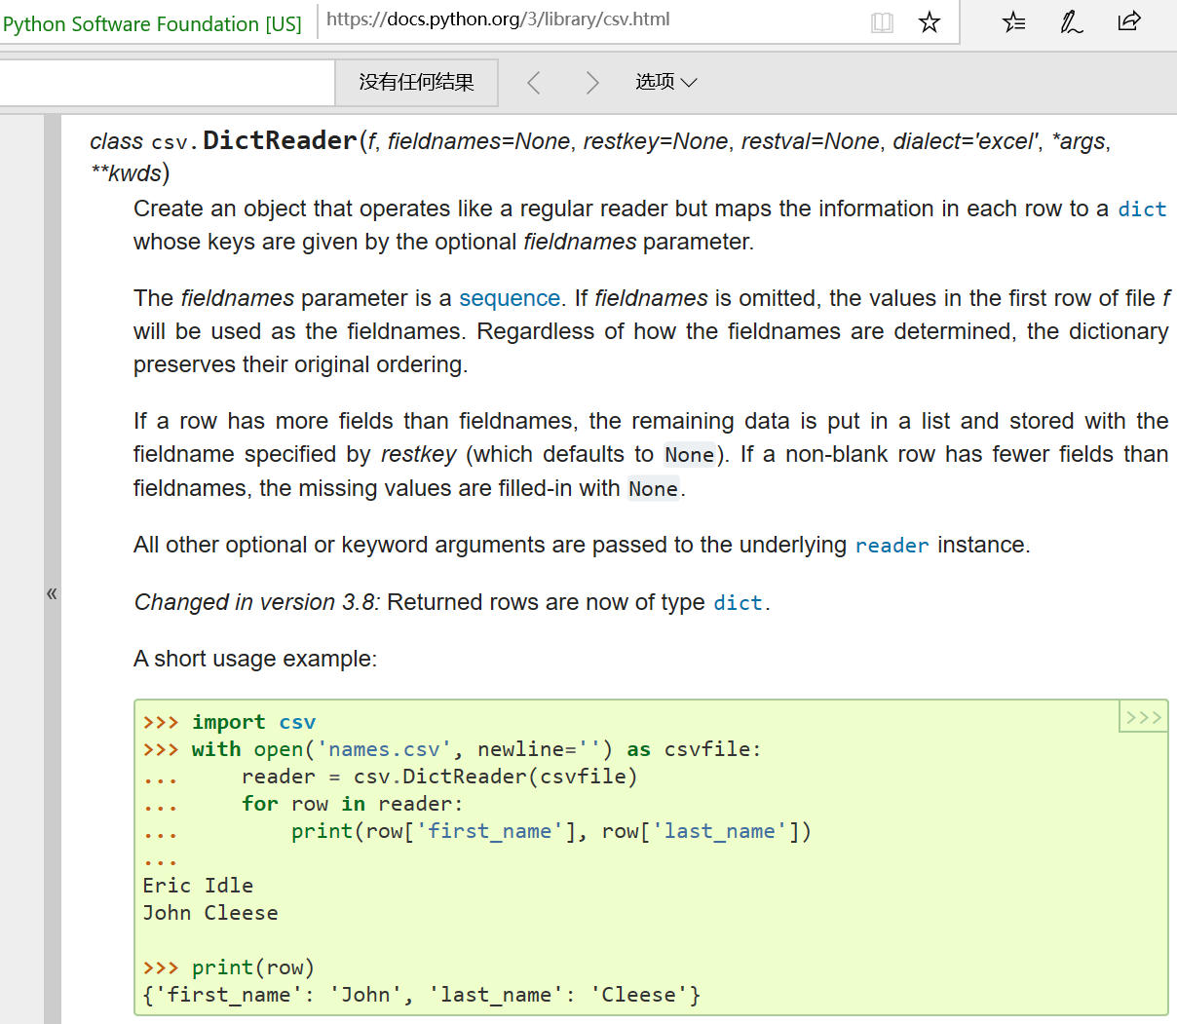
Notes:
https://docs.python.org/3/library/csv.html

Slide 48
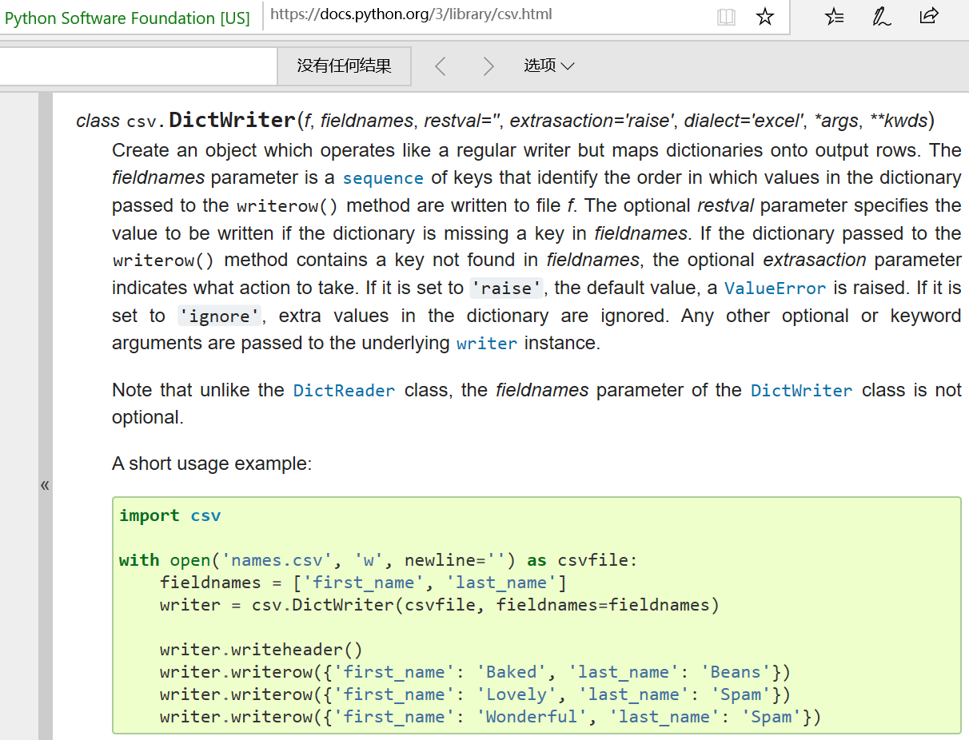
Notes:
https://docs.python.org/3/library/csv.html

Slide 49
设计图
注：实体名字和关系名字需要易懂，对于上述的要求，并不一定存在唯一的设计，只要能够覆盖上面这些要求即可。“ST”标记是⽤用来刻画⼀个股票严重亏损的状态，这个可以从给定的股票名字前缀来判断，背景知识可参考百科ST股票，“ST”股票对应列表为['*ST', 'ST', 'S*ST', 'SST']。

Slide 50
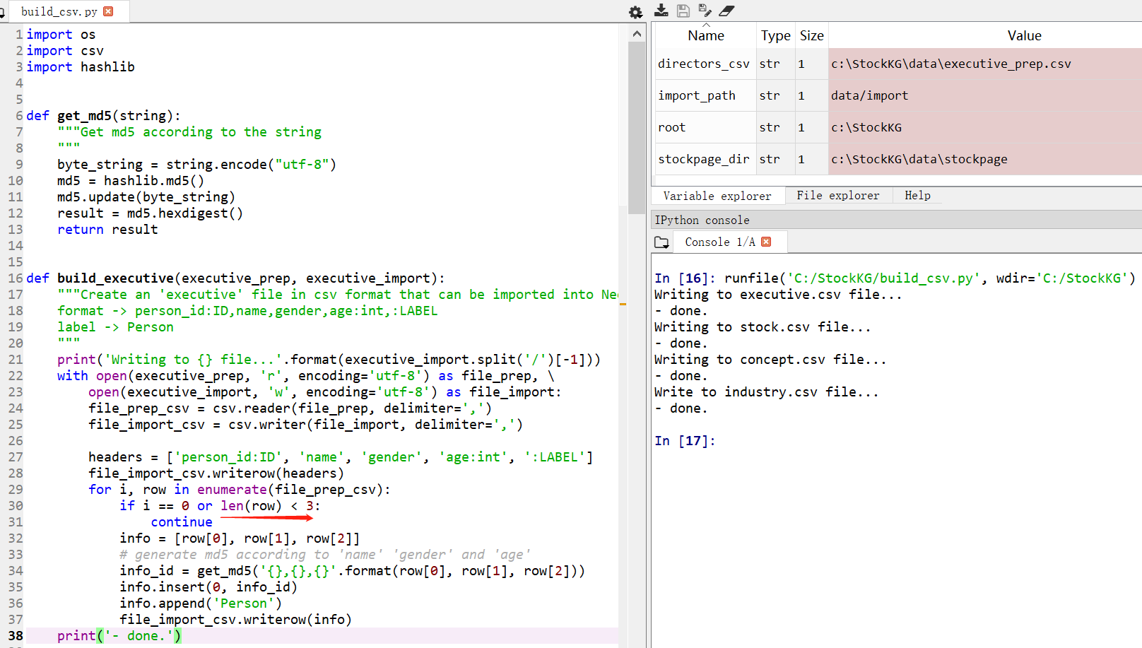
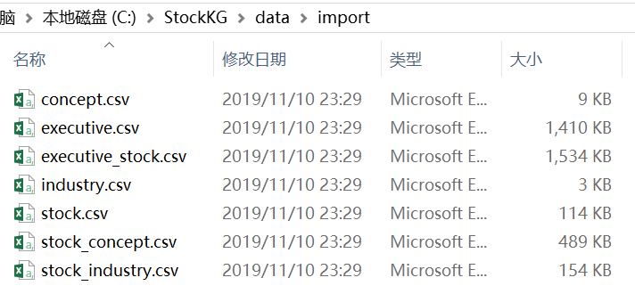
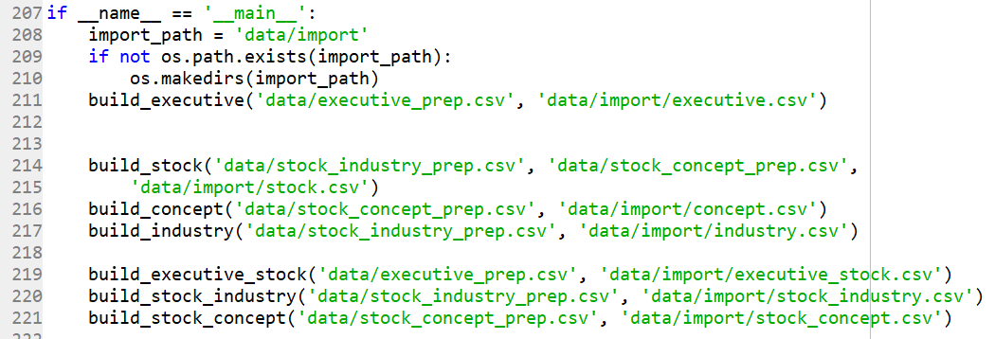
Notes:
import os
import csv
import hashlib
def get_md5(string):
"""Get md5 according to the string
"""
byte_string = string.encode("utf-8")
md5 = hashlib.md5()
md5.update(byte_string)
result = md5.hexdigest()
return result
def build_executive(executive_prep, executive_import):
"""Create an 'executive' file in csv format that can be imported into Neo4j.
format -> person_id:ID,name,gender,age:int,:LABEL
label -> Person
"""
print('Writing to {} file...'.format(executive_import.split('/')[-1]))
with open(executive_prep, 'r', encoding='utf-8') as file_prep, \
open(executive_import, 'w', encoding='utf-8') as file_import:
file_prep_csv = csv.reader(file_prep, delimiter=',')
file_import_csv = csv.writer(file_import, delimiter=',')
headers = ['person_id:ID', 'name', 'gender', 'age:int', ':LABEL']
file_import_csv.writerow(headers)
for i, row in enumerate(file_prep_csv):
if i == 0 or len(row) < 3:
continue
info = [row[0], row[1], row[2]]
# generate md5 according to 'name' 'gender' and 'age'
info_id = get_md5('{},{},{}'.format(row[0], row[1], row[2]))
info.insert(0, info_id)
info.append('Person')
file_import_csv.writerow(info)
print('- done.')
def build_stock(stock_industry_prep, stock_concept_prep, stock_import):
"""Create an 'stock' file in csv format that can be imported into Neo4j.
format -> company_id:ID,name,code,:LABEL
label -> Company,ST
"""
print('Writing to {} file...'.format(stock_import.split('/')[-1]))
stock = set() # 'code,name'
with open(stock_industry_prep, 'r', encoding='utf-8') as file_prep:
file_prep_csv = csv.reader(file_prep, delimiter=',')
for i, row in enumerate(file_prep_csv):
if i == 0:
continue
code_name = '{},{}'.format(row[0], row[1].replace(' ', ''))
stock.add(code_name)
with open(stock_concept_prep, 'r', encoding='utf-8') as file_prep:
file_prep_csv = csv.reader(file_prep, delimiter=',')
for i, row in enumerate(file_prep_csv):
if i == 0:
continue
code_name = '{},{}'.format(row[0], row[1].replace(' ', ''))
stock.add(code_name)
with open(stock_import, 'w', encoding='utf-8') as file_import:
file_import_csv = csv.writer(file_import, delimiter=',')
headers = ['stock_id:ID', 'name', 'code', ':LABEL']
file_import_csv.writerow(headers)
for s in stock:
split = s.split(',')
ST = False # ST flag
states = ['*ST', 'ST', 'S*ST', 'SST']
info = []
for state in states:
if split[1].startswith(state):
ST = True
split[1] = split[1].replace(state, '')
info = [split[0], split[1], split[0], 'Company;ST']
break
else:
info = [split[0], split[1], split[0], 'Company']
file_import_csv.writerow(info)
print('- done.')
def build_concept(stock_concept_prep, concept_import):
"""Create an 'concept' file in csv format that can be imported into Neo4j.
format -> concept_id:ID,name,:LABEL
label -> Concept
"""
print('Writing to {} file...'.format(concept_import.split('/')[-1]))
with open(stock_concept_prep, 'r', encoding='utf-8') as file_prep, \
open(concept_import, 'w', encoding='utf-8') as file_import:
file_prep_csv = csv.reader(file_prep, delimiter=',')
file_import_csv = csv.writer(file_import, delimiter=',')
headers = ['concept_id:ID', 'name', ':LABEL']
file_import_csv.writerow(headers)
concepts = set()
for i, row in enumerate(file_prep_csv):
if i == 0:
continue
concepts.add(row[2])
for concept in concepts:
concept_id = get_md5(concept)
new_row = [concept_id, concept, 'Concept']
file_import_csv.writerow(new_row)
print('- done.')
def build_industry(stock_industry_prep, industry_import):
"""Create an 'industry' file in csv format that can be imported into Neo4j.
format -> industry_id:ID,name,:LABEL
label -> Industry
"""
print('Write to {} file...'.format(industry_import.split('/')[-1]))
with open(stock_industry_prep, 'r', encoding="utf-8") as file_prep, \
open(industry_import, 'w', encoding='utf-8') as file_import:
file_prep_csv = csv.reader(file_prep, delimiter=',')
file_import_csv = csv.writer(file_import, delimiter=',')
headers = ['industry_id:ID', 'name', ':LABEL']
file_import_csv.writerow(headers)
industries = set()
for i, row in enumerate(file_prep_csv):
if i == 0:
continue
industries.add(row[2])
for industry in industries:
industry_id = get_md5(industry)
new_row = [industry_id, industry, 'Industry']
file_import_csv.writerow(new_row)
print('- done.')
def build_executive_stock(executive_prep, relation_import):
"""Create an 'executive_stock' file in csv format that can be imported into Neo4j.
format -> :START_ID,title,:END_ID,:TYPE
person stock
type -> employ_of
"""
with open(executive_prep, 'r', encoding='utf-8') as file_prep, \
open(relation_import, 'w', encoding='utf-8') as file_import:
file_prep_csv = csv.reader(file_prep, delimiter=',')
file_import_csv = csv.writer(file_import, delimiter=',')
headers = [':START_ID', 'jobs', ':END_ID', ':TYPE']
file_import_csv.writerow(headers)
for i, row in enumerate(file_prep_csv):
if i == 0 or len(row)<5:
continue
# generate md5 according to 'name' 'gender' and 'age'
start_id = get_md5('{},{},{}'.format(row[0], row[1], row[2]))
end_id = row[3] # code
relation = [start_id, row[4], end_id, 'employ_of']
file_import_csv.writerow(relation)
def build_stock_industry(stock_industry_prep, relation_import):
"""Create an 'stock_industry' file in csv format that can be imported into Neo4j.
format -> :START_ID,:END_ID,:TYPE
stock industry
type -> industry_of
"""
with open(stock_industry_prep, 'r', encoding='utf-8') as file_prep, \
open(relation_import, 'w', encoding='utf-8') as file_import:
file_prep_csv = csv.reader(file_prep, delimiter=',')
file_import_csv = csv.writer(file_import, delimiter=',')
headers = [':START_ID', ':END_ID', ':TYPE']
file_import_csv.writerow(headers)
for i, row in enumerate(file_prep_csv):
if i == 0:
continue
industry = row[2]
start_id = row[0] # code
end_id = get_md5(industry)
relation = [start_id, end_id, 'industry_of']
file_import_csv.writerow(relation)
def build_stock_concept(stock_concept_prep, relation_import):
"""Create an 'stock_industry' file in csv format that can be imported into Neo4j.
format -> :START_ID,:END_ID,:TYPE
stock concept
type -> concept_of
"""
with open(stock_concept_prep, 'r', encoding='utf-8') as file_prep, \
open(relation_import, 'w', encoding='utf-8') as file_import:
file_prep_csv = csv.reader(file_prep, delimiter=',')
file_import_csv = csv.writer(file_import, delimiter=',')
headers = [':START_ID', ':END_ID', ':TYPE']
file_import_csv.writerow(headers)
for i, row in enumerate(file_prep_csv):
if i == 0:
continue
concept = row[2]
start_id = row[0] # code
end_id = get_md5(concept)
relation = [start_id, end_id, 'concept_of']
file_import_csv.writerow(relation)
if __name__ == '__main__':
import_path = 'data/import'
if not os.path.exists(import_path):
os.makedirs(import_path)
build_executive('data/executive_prep.csv', 'data/import/executive.csv')
build_stock('data/stock_industry_prep.csv', 'data/stock_concept_prep.csv',
'data/import/stock.csv')
build_concept('data/stock_concept_prep.csv', 'data/import/concept.csv')
build_industry('data/stock_industry_prep.csv', 'data/import/industry.csv')
build_executive_stock('data/executive_prep.csv', 'data/import/executive_stock.csv')
build_stock_industry('data/stock_industry_prep.csv', 'data/import/stock_industry.csv')
build_stock_concept('data/stock_concept_prep.csv', 'data/import/stock_concept.csv')

Slide 51
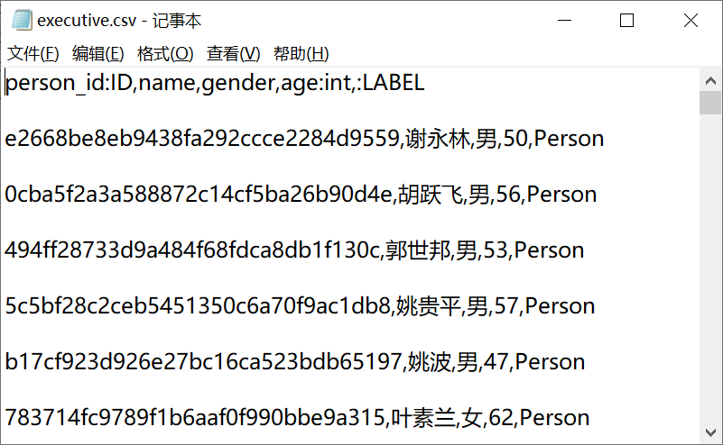
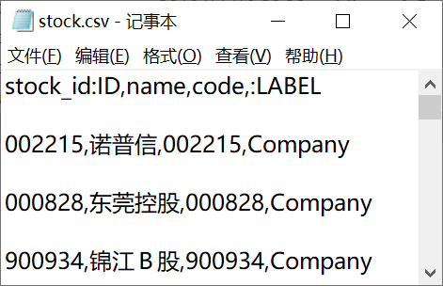



Slide 52




Slide 53
用到软件
neo4j-community-3.5.12-windows.zip 151MB
jdk-13.0.1_windows-x64_bin.exe 164MB

Slide 54
可视化没跑通
最后一步，数据可视化，灌到图数据库neo4j报错。
无论是用用作者提供的数据，还是我自己生成的数据都灌不进去，错误提示如下图。
TAs, 你们来解决知识图谱，最后一步neo4j的可视化问题。

Slide 55

Notes:
https://anaconda.org/conda-forge/neo4j-python-driver

Slide 56


Slide 57


Slide 58


Slide 59
END

